Slide 1
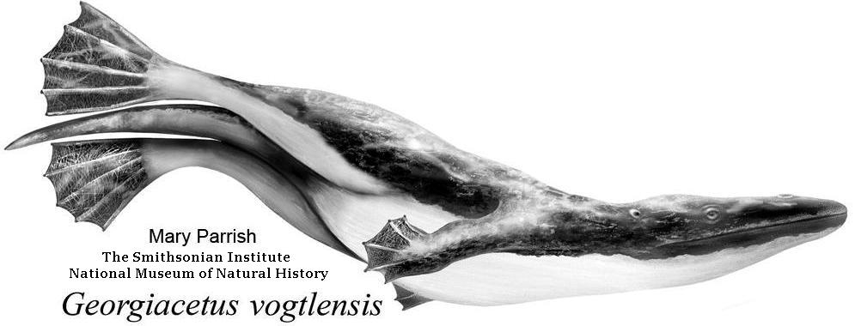
Georgia’s Fossils
A 500 Million Year Record
Thomas Thurman
Author, Amateur Paleontologist & Natural Historian

Slide 2
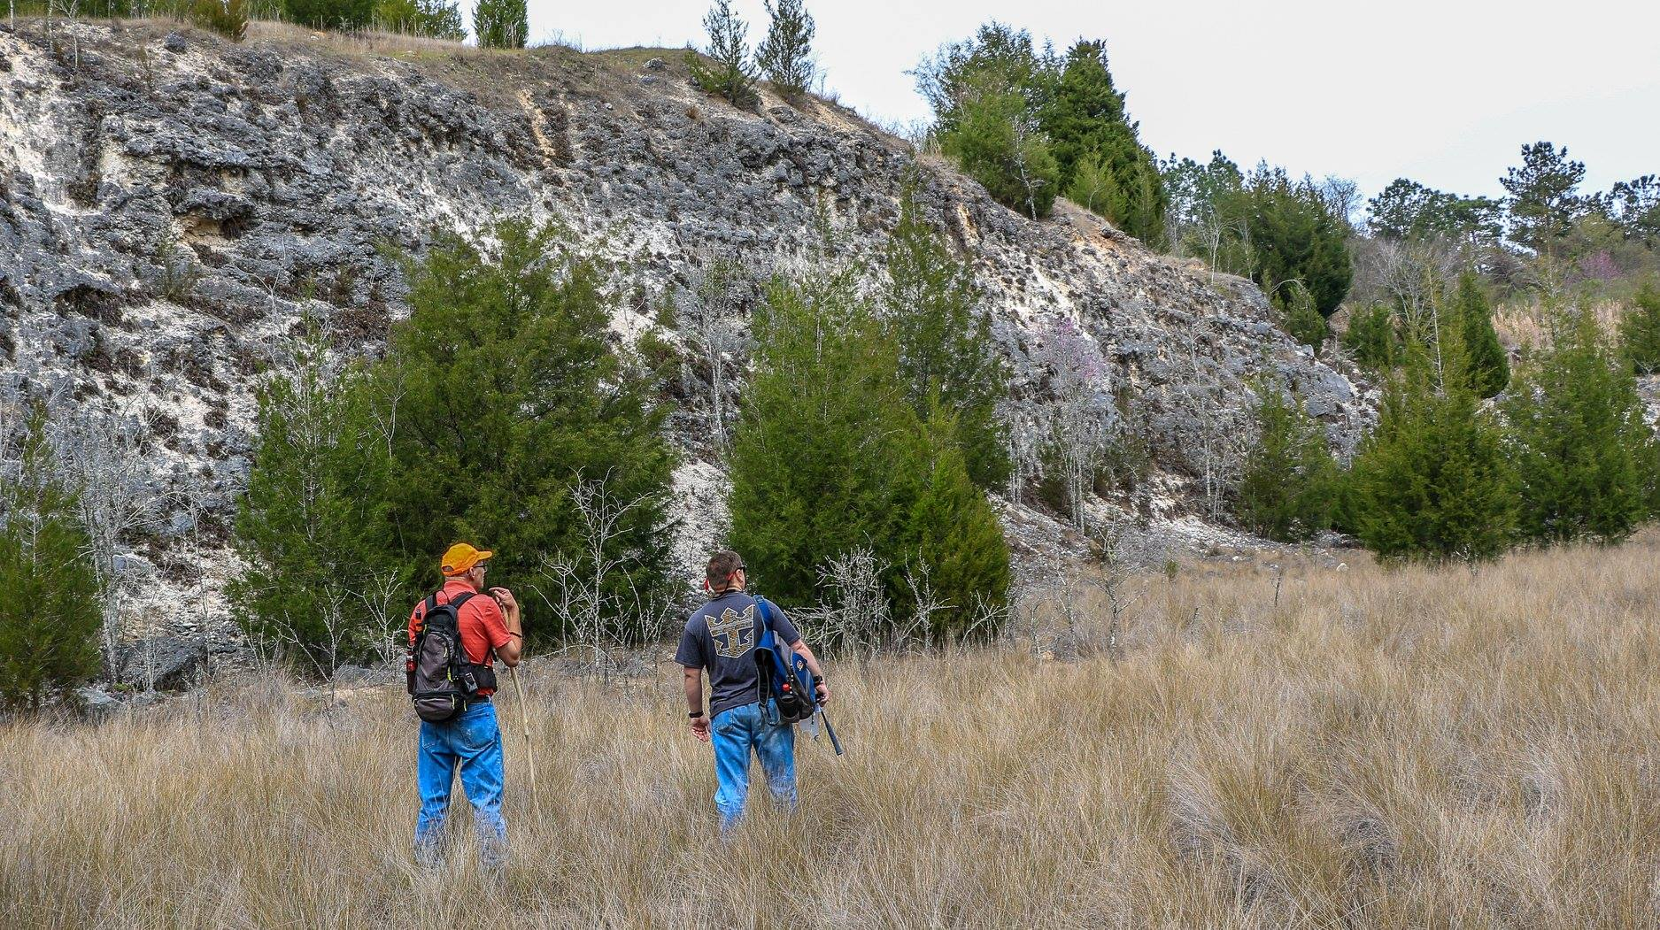
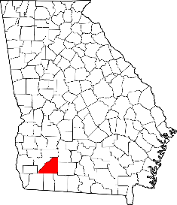
It’s all about exploring Georgia.
Georgia’s Natural History is amazingly complex.
New discoveries continue despite 250 years of active research.
Mitchell
County
Thomas Thurman & Hank Josey in the field; Paleontology Association of Georgia dig. Bridgeboro Limestone 10/March/2018 Image by Jim Seuffelein (PAG member)

Slide 3
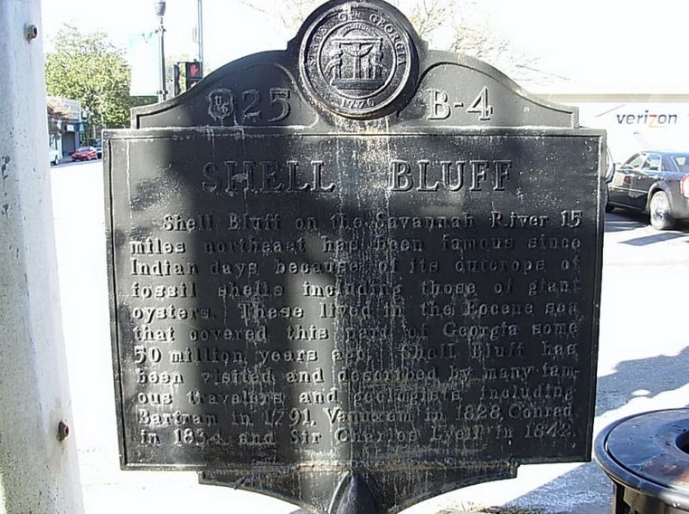
Georgia’s Most Historic Fossil
The Inscription Reads
Shell Bluff on the Savannah River 15 miles northeast has been famous since Indian days because of its outcrops of fossil shells including those of giant oysters.
These lived in the Eocene sea that covered this part of Georgia some 50 million years ago.
Shell Bluff has been visited and described by many famous travelers and geologists including Bartram in 1791, Vanuxem in 1828, Conrad in 1834, and Sir Charles Lyell in 1842.
Shell Bluff &
The giant 34 million year old oysters.
This historical marker stands near the
Waynesboro, Georgia Post Office.

Slide 4
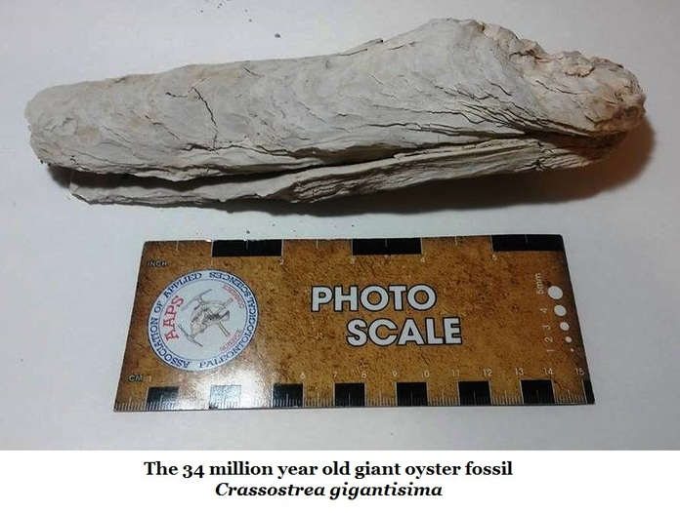
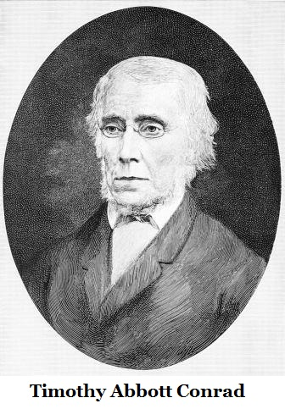
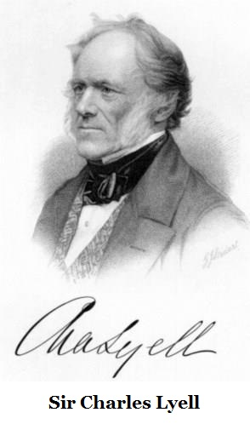
The Giant Oyster, Crassostrea gigantissima
John & William Bartram visited the Shell Bluff and collected oysters in September of 1765. William Bartram described these fossils as a “curious phenomenon” in his famous 1791 book on his travels.
Note; Paleontology wasn’t established as a science until Georges Buffon published his 1778 book Epochs of Nature.
Timothy A. Conrad was an early Georgia researcher and worked to established paleontology in our state. He collected these fossils in 1834.
Sir Charles Lyell
Visited the USA & Georgia during the early 1840s. He also visited Shell Bluff when he collected these oysters.
Lyell authored the books Principals of Geology (1830) & founded the principal of Uniformitarianism; the idea that the Earth was shaped by the same scientific processes in operation today. He stood as friend & mentor of Charles Darwin.

Slide 5
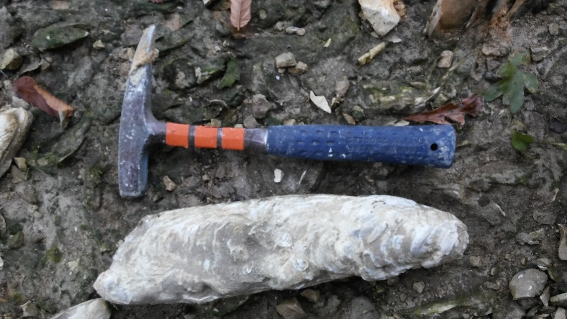
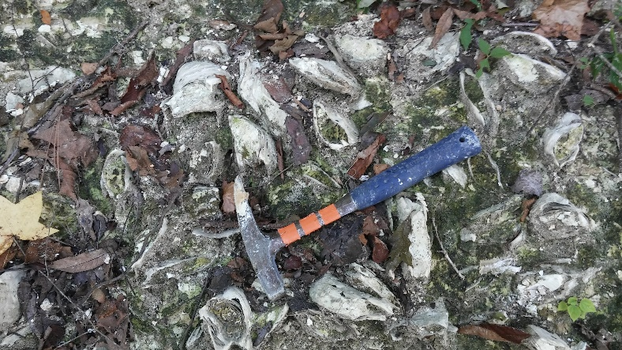
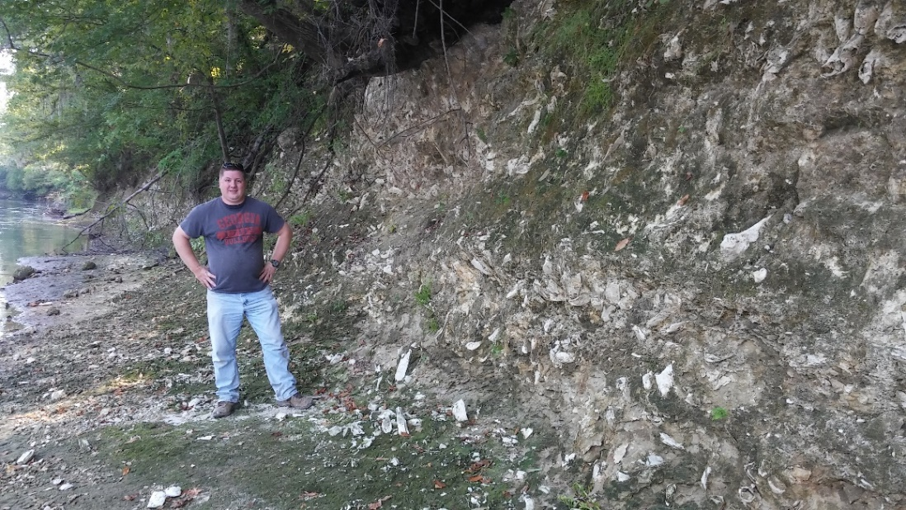
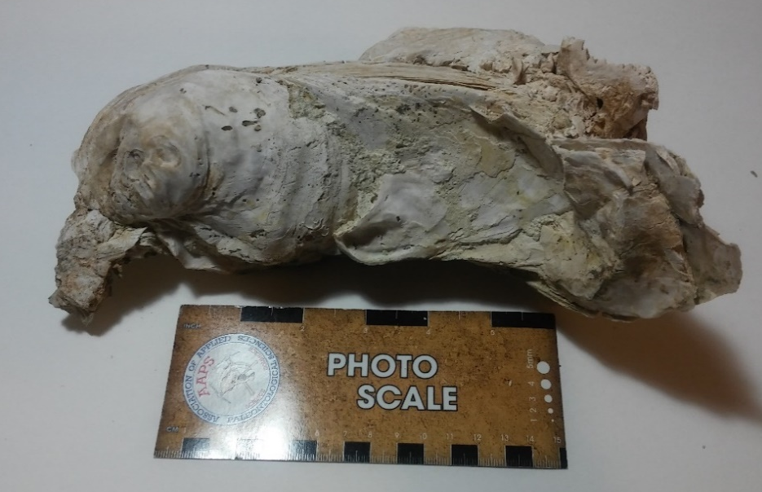
Crassostrea gigantissima
Yuchi Wildlife Management Area
Burke County, GA.
These Crassotrea giantissama lived about 34 million years ago.
The species is extinct but the members of the genus still exist as an important food source (Crassostrea gigas).
They live in the inter-tidal zone so they’re often exposed during low tide.
They do well in waters with a low nutrient supply.
As true oysters of the order Ostreoida they do not produce pearls.
Hank Josey,
VP Paleontology Association of Georgia

Slide 6
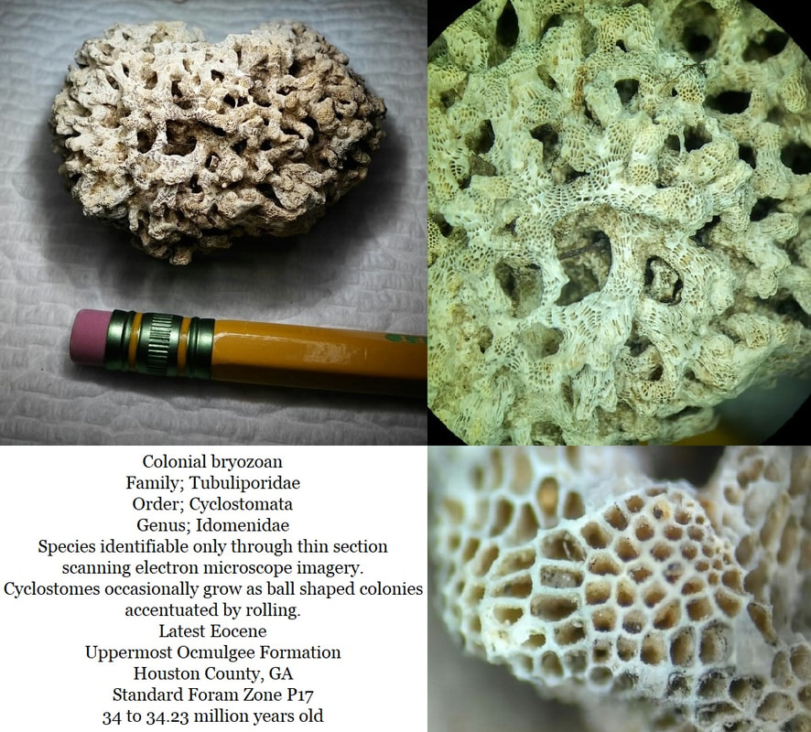
On a hilltop in Oaky Woods Wildlife Management Area Hank Josey and I found these Cyclostomata colonial bryozoans.
*
It took a year to properly identify them.
*
Noted as “Beautiful Specimens” they’re currently being studied by four Southeastern universities & natural history museums.
*
The Natural History Museum in London, where Charles Darwin’s collection is housed, has also requested specimens.
Discoveries continue even among amateurs

Slide 7
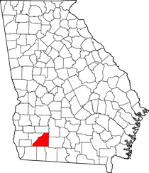
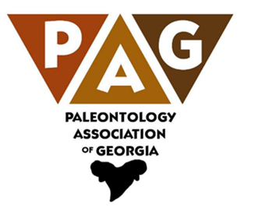
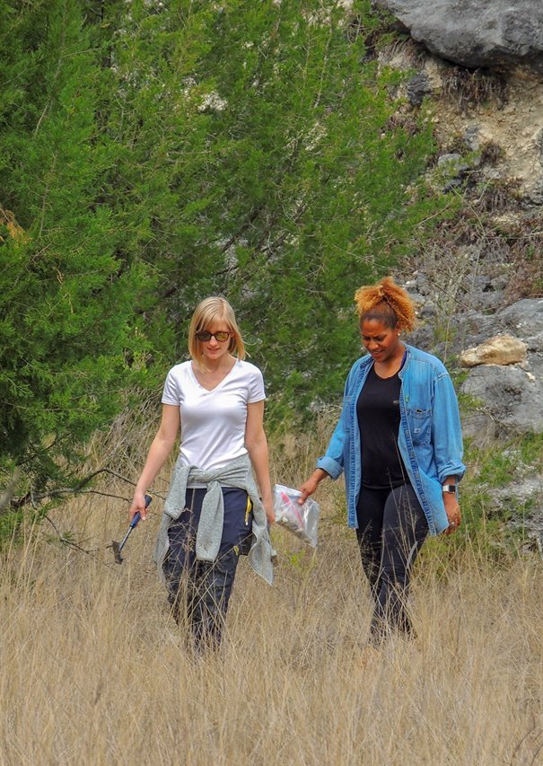
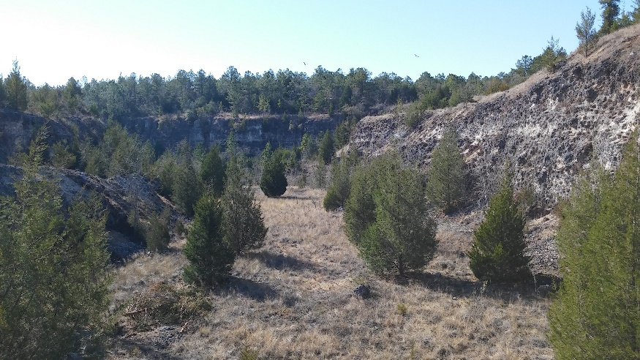
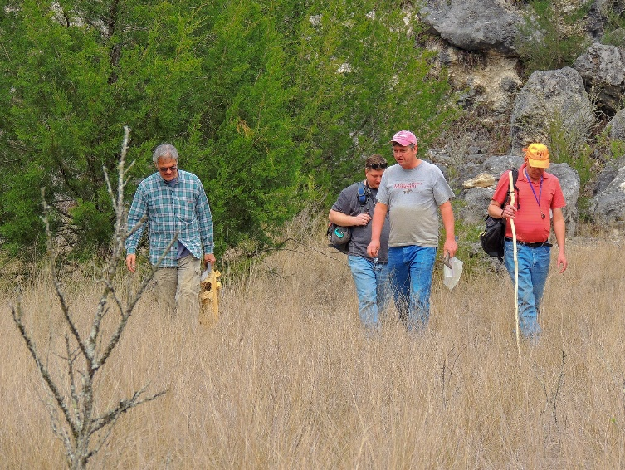
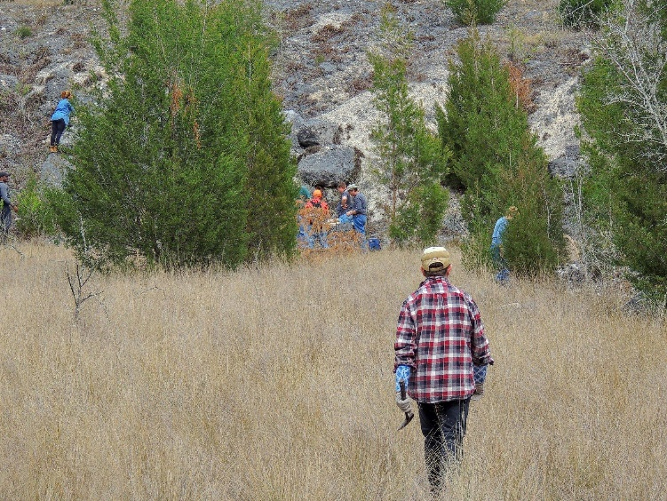
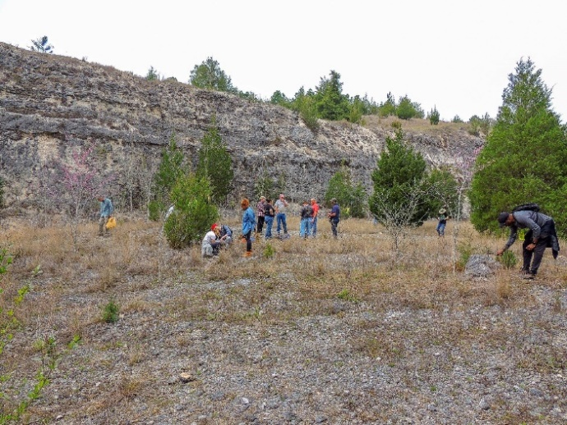
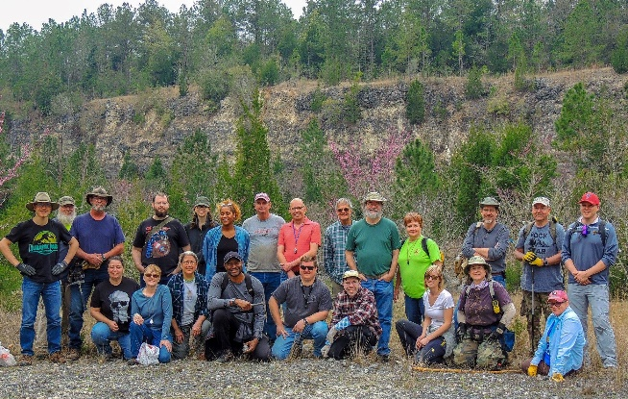
10/March/2018
The Bridgeboro Limestone Dig
Paleontology Association of Georgia
30 million year old sediments
Just a few miles north-east of Camilla, GA
Georgia Teacher Participation
Teachers participated
You too can explore Georgia

Slide 8
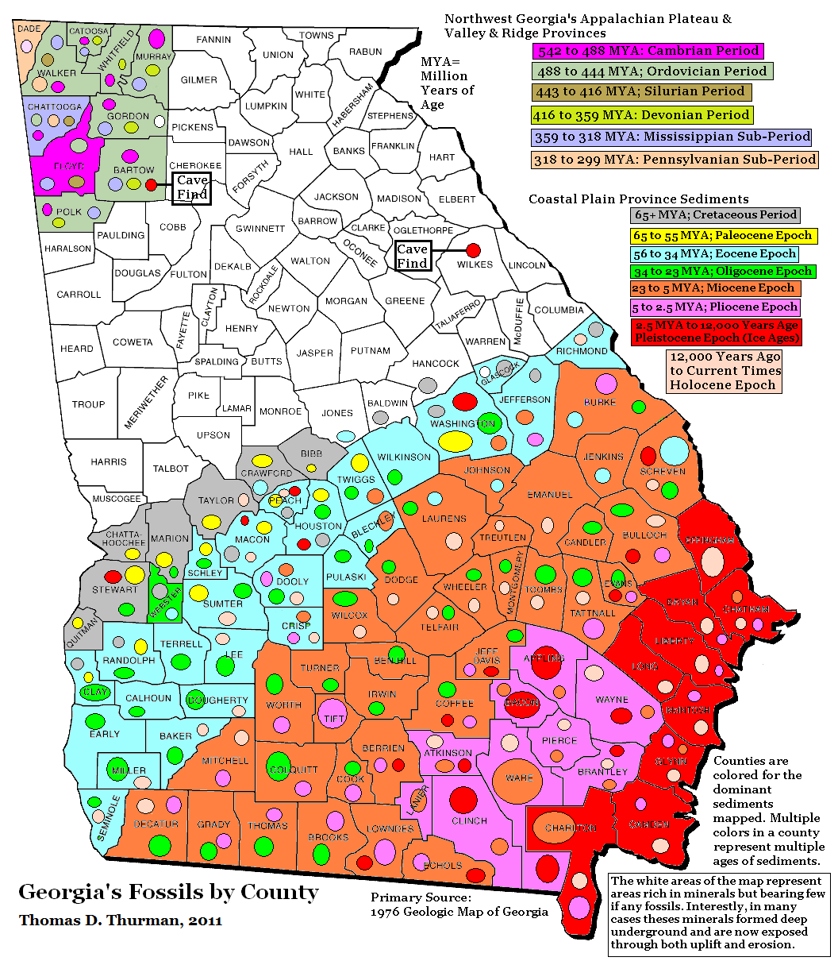
Georgia Fossil Map
by County
Georgia Can Illustrate
Climate change
Evolution
Geologic time
Meteorites
Paleontology
Plate tectonics
Sea level change
Volcanoes

Slide 9
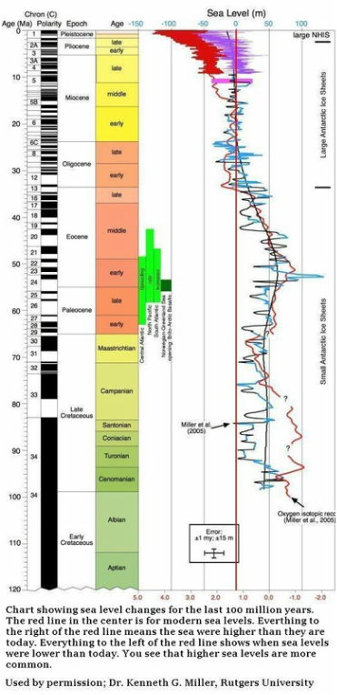
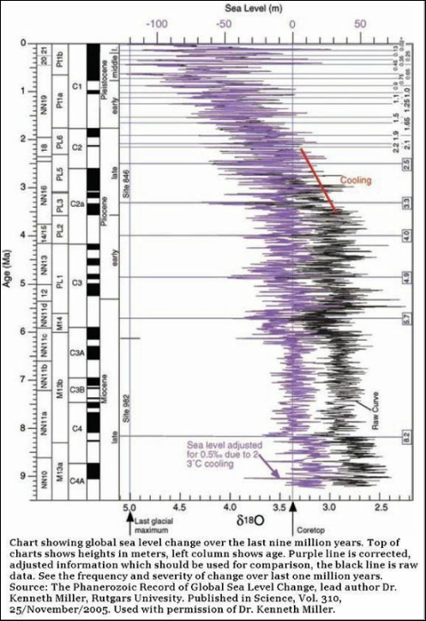
Sea Level Change
A Global History
100 million years of history
The last 10 million years of history

Slide 10
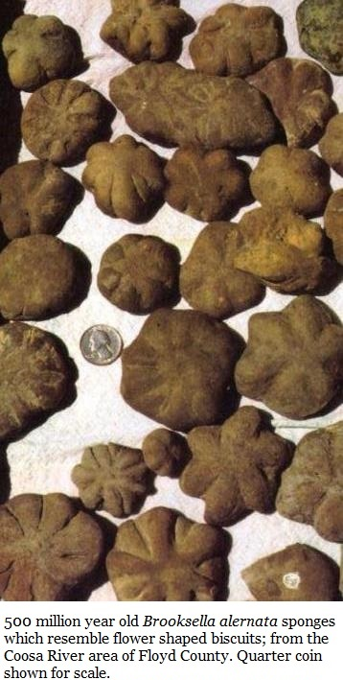
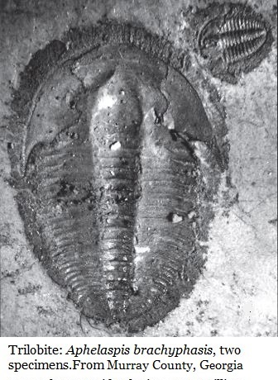
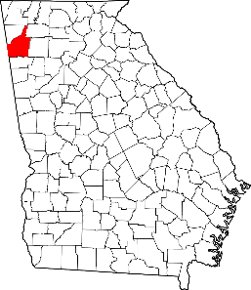
Georgia’s Oldest Fossils
500 million years ago
As early as 1884
Charles Doolittle Walcott published research describing Georgia’s trilobite specimens.
When these animals lived…
Georgia was in the Southern Hemisphere
There were no bones, enameled teeth, vascular plants, or insects anywhere on the planet.
The seas were full of life but terrestrial Earth was barren
Floyd County
Time:
Middle Cambrian

Slide 11
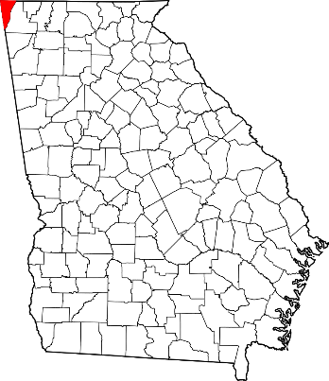
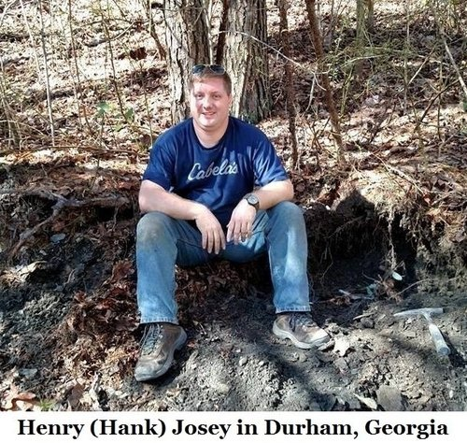
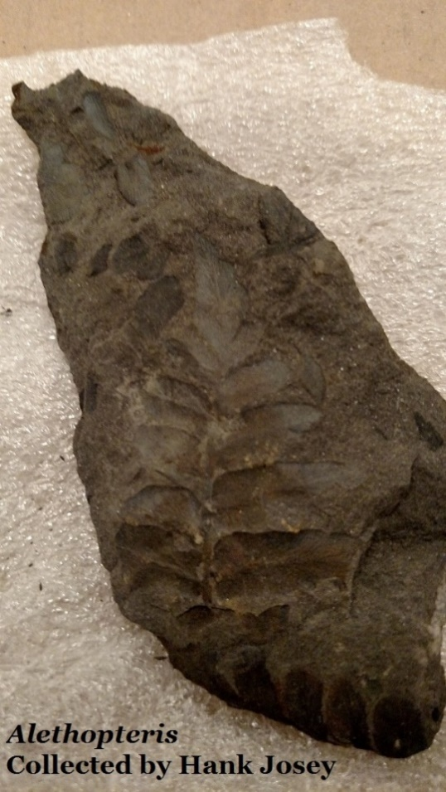
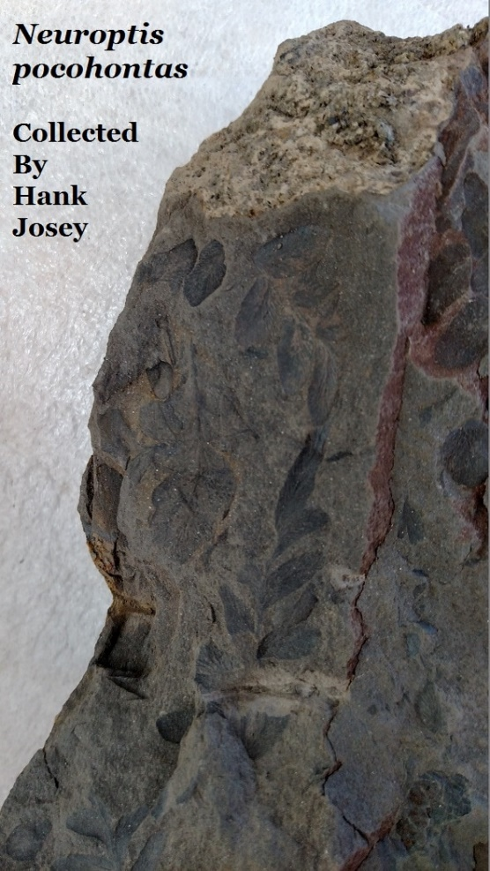
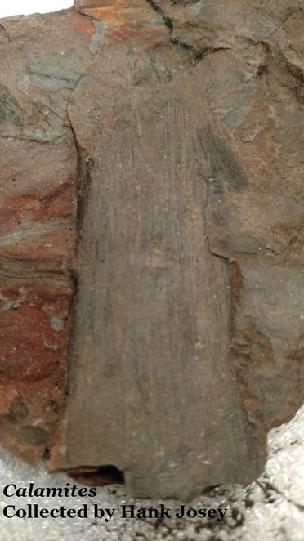
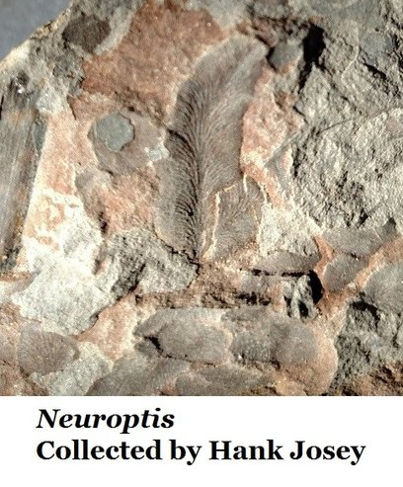
Georgia’s Pennsylvanian Plant Fossils Appro. 315-323 million years old Henry (Hank) N. Josey, PharmD.
Dade County
In the abandoned coal fields of Dade and Walker Counties, inactive since the 1950s, plant fossils are commonplace in shale and sandstone.

Slide 12
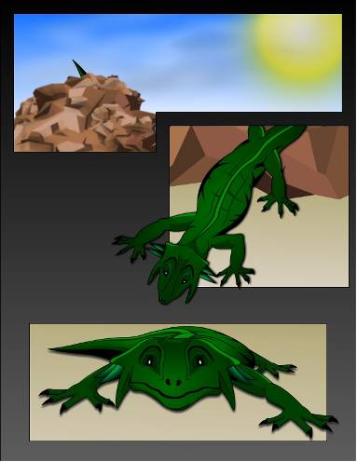
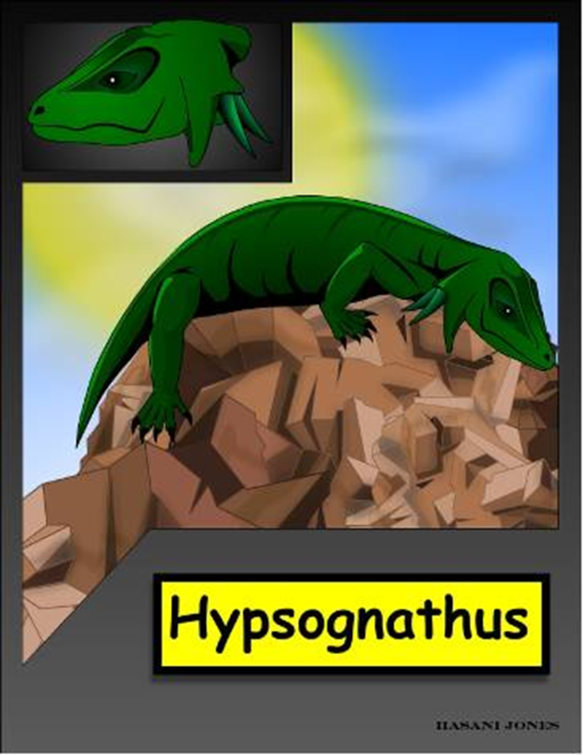
Dr. Tim Chowns at the University of West Georgia
reports that a Hypsognathus was discovered near Savannah in a drill core sample from more than 2,000 feet deep.
Time;
Upper Triassic
Hypsognathus is about 12 inches long, lived about 200 million years ago.
It lived in the Dunbarton Basin, a rift valley, created when plate tectonics attempted, but failed, to open the Atlantic Ocean.
The Atlantic opened about 130 million years ago.

Slide 13
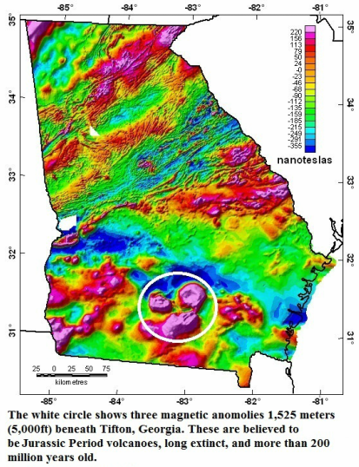
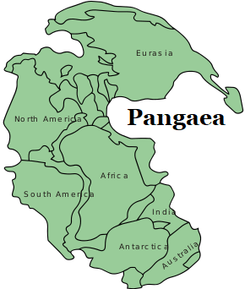
Plate Tectonics
& Georgia
The break-up of Pangaea is part of the Dunbarton Basin rift valley story.
Dunbarton Basin, a rift valley, was formed when the terrific forces of continental drift (plate tectonics) tried, long ago to slowly rip Pangaea, and of course Georgia, in half.
The Atlantic formed when plate tectonics succeeded in rifting Pangaea
At different points in our state’s long history, some areas were crushed by continental drift while others were stretched like taffy.
Tifton GA is about 380 feet above sea level

Slide 14
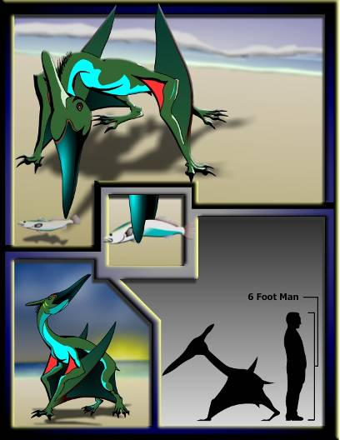
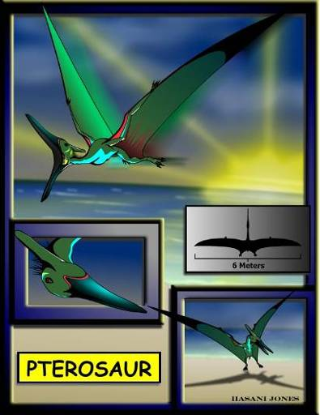
Pterosaurs flew over Georgia
83 million years ago.
Time;
Upper Cretaceous
In 1985 David Schwimmer, Kevin Padian, & Alfred Woodhead reported pterosaur fossils from Fort Benning, GA, in Muscogee County. Multiple fossils were recovered.

Slide 15
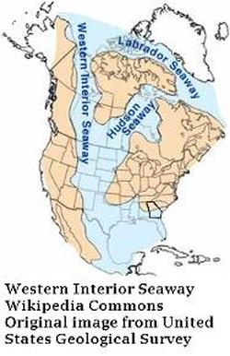
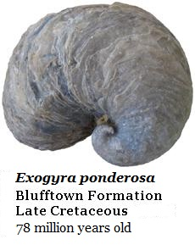
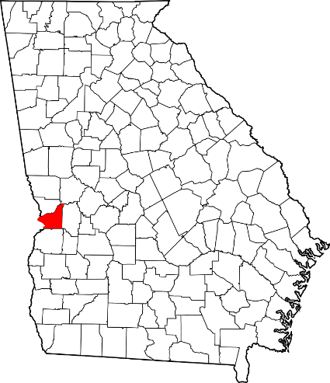
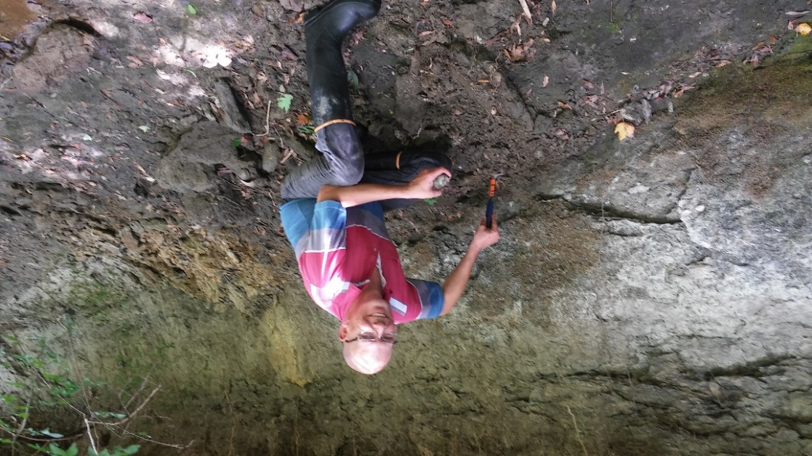
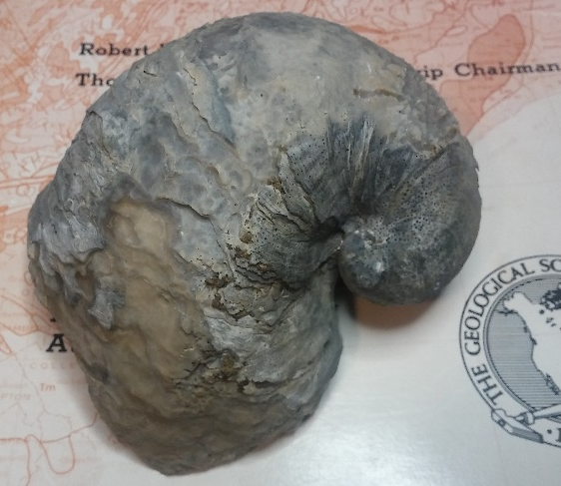
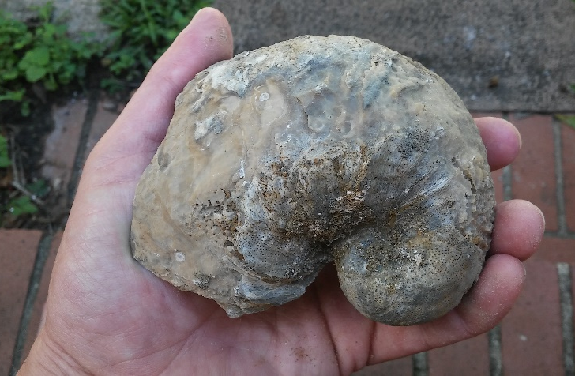
Well known for over a century…
*
78 million year old, fist sized, Exogyra ponderosa oysters densely occur in 3 meter thick (10 ft) beds in West Georgia.
*
Millions of individuals occur, and the only real economic value would be education.
Exogyra ponderosa
Dinosaurs walked Georgia when these oysters lived.
Chattahoochee County
Time;
Upper Cretaceous

Slide 16
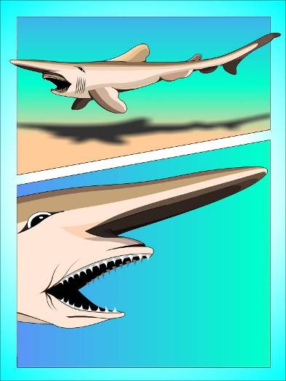
The goblin shark
Scapanorhynchus texanus
78 million years old, Chattahoochee County
Georgia’s most common Cretaceous fossil.
Time;
Upper Cretaceous

Slide 17
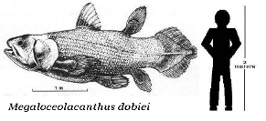
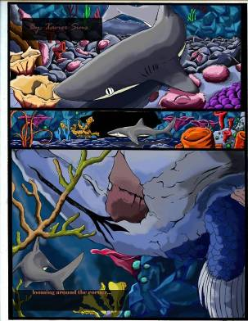
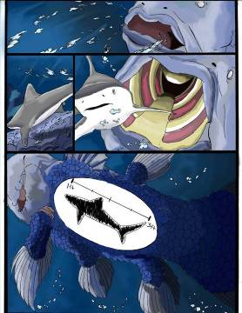
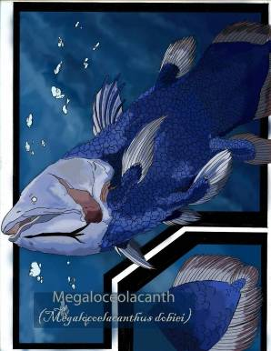
Megalocoelacanthus dobiei
78 million years olds
Described in 1994 by David Schwimmer,
J. D. Steward & Dent Williams.
A new genus & species named from Georgia & Alabama fossils.
***Misidentified Museum Discovery***
Time;
Upper Cretaceous
In 1994 David Schwimmer, J. D. Steward & Dent Williams
described this new species.

Slide 18
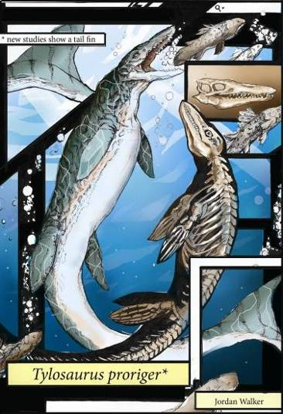
The mosasaur Tylosaurus hunted Georgia’s lost sea 78 million years ago.
Known from Chattahoochee & other West Georgia counties
Mosasaurs have been known from Georgia’s fossil record for more than a century

Slide 19
Deinosuchus; The Terrible Crocodile, has been deeply studied by Dr. David Schiwmmer at Columbus State University and is well known from Georgia’s Fossil Record.
David Schwimmer’s
Superb book on Deinosuchus
King of the Crocodilians
published in 2002
Probably a dinosaur eating crocodile.
Populations occurred in Texas and Georgia, on both coast of the Western Interior Seaway.
Individuals on the Georgia side tended to be smaller, but populations were denser.
Chattahoochee County

Slide 20
Appalachiosaurus montgomeriensis
78 million years ago
Illustration of an adolescent animal.
In 2005 Appalachiosaurus was described as a new species occurring in Alabama, it also occurs in Georgia

Slide 21
78 million years ago
Ostrich-like Dinosaurs
hunted Georgia.
Reported in 1993 by
David Schwimmer, J. Dent Williams, James Dobie & William Siesser,
these dinosaurs hunted Georgia

Slide 22
Duck-Billed Dinosaurs
in West Georgia
As shown by Dr. David Schwimmer Hadrosaurs, the duck-billed dinosaurs, also walked Georgia 78 million years ago.
Not enough remains have yet been found of any individual to identify a specific species.
Single bones are frequently found in the sediments, suggestion a population.
Perhaps they were victims of a Deinosuchus.
Perhaps an animal drowned during a crossing of the paleo-Chattahoochee River and dismembered by some of the many predators we’ve seen.

Slide 23
The Suwannee Current & Gulf Trough
Research by Dr. Burt Carter at Georgia Southwestern
revealed that for 40 million years a powerful current crossed
south Georgia, carving a vast canyon, which was
completely buried by later large scale erosion.
The Suwannee Current rose while dinosaurs walked Georgia
but long outlasted them.
Mitchell County
It was the rhodoliths which told the story

Slide 24
Georgiacetus vogtlensis (the Georgia Whale) A new species from Georgia
40 million years old
The likely ancestor to all modern whales.
The fossils from 3 individuals were discovered during the 1983 construction of Nuclear Power Plant Vogtle and described by Richard Hulbert.
Its a transition fossil between walking & swimming whales, it likely possessed well developed hind legs but it’s hips weren’t fused to it’s spine so it couldn’t support it’s own weight out of the water.
In 2008 Mark Uhen confirmed additional individuals from Alabama, Mississippi and Texas.
Uhen also showed the apparent ancestry linking Georgiacetus to modern whales through similarities in the structure of the skeleton & skulls.
Burke County
Our Georgia Whale was shown to likely lack flukes when a flanged end-of-tail vertebra was found.
Time; Middle Eocene

Slide 25
Time;
Late
Eocene
The family of basilosaurids are the first whales to posses flukes.
They’re well known from Georgia’s 37 million year old sediments
(Georgiacetus is the apparent ancestor to the basilosaurid family)
The Basilosaurid family possessed the same
end-of-tail arrangement as all modern whales. Thus they very likely possessed flukes.
Yet the skull is clearly descended from Georgiacetus.
Vestigial legs
The basilosaurids are a large family of whales ranging from dolphin sized to the first great whales.

Slide 26
Oaky Woods Wildlife Management Area
Houston County, GA
33.9 million year old sediments
Just before & after
the Eocene/Oligocene extinction event
See GeorgiasFossils.com, Section 13H
Houston County
A GeorgiasFossils.com amateur research project through the Georgia Department of Natural Resources
Wildlife Management Division
Amateurs can contribute directly to science!

Slide 27
In 2005 Dennis Parmley and David J. Cicimurri reported a single brontothere tooth from sediments in Gordon, Georgia, Wilkinson County.
Wilkinson County
Brontotheres walked Georgia
35 million years ago

Slide 28
Terminator Pigs (Entelodonts)
Walked Georgia 34 million years ago.
Their fossils occur in
Twiggs & Houston Counties
Twiggs County

Slide 29
C. megalodon
The largest shark that ever lived is well known from Georgia.
Adults reached at least 52 feet in length, and may have exceeded 67 feet in length.
There is strong evidence that they actively hunted whales.
17.5 cm or (6.9”) megalodon tooth
Chatham & other Coastal Counties
13.5mm (5.3”) megalodon tooth &
great white shark teeth.
Time: Miocene Epoch

Slide 30
Scaldicetus; the killer sperm whale
growing to nearly 23 feet.
23.3 to 5.3 million years ago
Scaldicetus & megalodon are present
in the sea which covered South Georgia.
There is evidence that megalodon hunted Scaldicetus.

Slide 31
Georgia Rhinos
Roughly 5.5 to 2.3 million years ago, rhinos walked Georgia.
Not enough fossils were found for identification to the level of genus,
but Teleoceras is confirmed & common in Florida, so likely occurred in Georgia too.
Teleoceras possibly fed at night
Teleoceras is a genus of grazing, heavy bodied, short legged rhinos with a single small horn.

Slide 32
The Terror Bird Titanus walleri, very likely occurred in Georgia during the Pliocene, it is known from Mexico, Texas & Florida, but fossils have yet to be confirmed in the Peach State.
Terror birds &
Three-Toed Horses
Terror birds likely hunted the Hipparion horse which was common in Florida & Georgia during the Pliocene. Known as the three-toed horse, two of the horse’s toes didn’t reach the ground so it walked on a single toe per foot like modern horses.

Slide 33
Most recently; we have Pleistocene Fossils
2.5 million to 11,000 years ago
The modern gray whale, Eschrichtius robustus,
occurs in Georgia’s Pleistocene or Ice Age sediments.
Time; Pleistocene Epoch

Slide 34
The Pleistocene saw several ground sloths in Georgia including Eramotherium laurillardi which
stood more than 20 feet tall on its hind legs.
There’s no reason to believe any of our sloths were particularly slow

Slide 35
In 2006 Dr. Al Mead at Georgia College showed that herds of giant bison walked Georgia 21,000 years ago, several individuals were reported in a single find near Brunswick.

Slide 36
Ice Age mammoths also walked Georgia. Columbian mammoths were originally named from a Georgia fossil by the Scottish Paleontologist Hugh Falconer. During Sir Charles Lyell’s 1846 Georgia visit. He was given a fossilized tooth by Hamilton Cooper which had been discovered during canal work in the Brunswick, Georgia area.
Lyell passed the tooth to Hugh Falconer, who used it to establish the species Mammuthus columbi; the Columbian Mammoth.

Slide 37
At 17,000 years ago we have both the Columbian Mammoth and Humans,
the Clovis People, in Georgia
And while this is still the Pliestocene; we are approaching the Holocene Epoch which began 11,650 years ago; the time of human domination of the world.

Slide 38
From trilobites, through dinosaurs, the origins of whales,
and on to mammoths….
Georgia’s fossil record is deep, rich, and diverse.
And almost unknown by Georgia’s students, parents & teachers.
See
Georgia’s Fossils Group on
Facebook
Both are on Facebook

