Slide 1
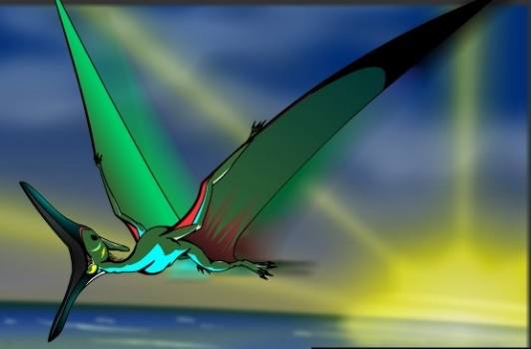
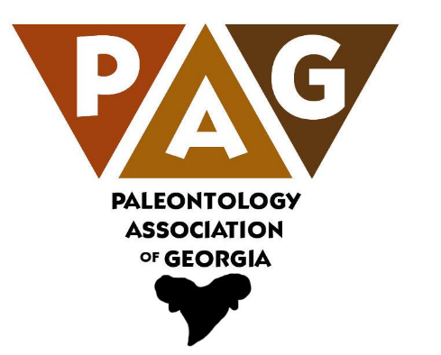
Georgia’s Fossils
A 500 Million Year Record
Thomas Thurman
Author,
Amateur Paleontologist
& Natural Historian
Hank Josey
Vice President
Paleontology Association
of Georgia & Natural Historian

Slide 2
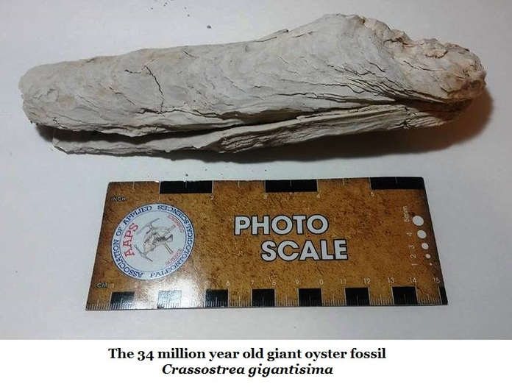
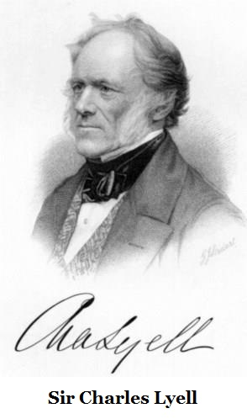
The Giant Oyster, Crassostrea gigantissima
Our most historic fossil with records dating to 1765
John & William Bartram
Visited Shell Bluff and collected these oysters in September of 1765.
William Bartram described these fossils as a “curious phenomenon” in his famous 1791 book on his travels.
Paleontology wasn’t established as a science until Georges Buffon published his 1778 book Epochs of Nature.
Timothy A. Conrad was an early Georgia researcher and worked to established paleontology in our state. He collected these fossils in 1834.
Sir Charles Lyell
I mentioned Lyell’s visit to Brown’s Mount during the early 1840s. He also visited Shell Bluff when he collected these oysters.
Sir Charles Lyell authored the books Principals of Geology (1830) & founded the principal of Uniformitarianism; the idea that the Earth was shaped by the same scientific processes still in operation today.

Slide 3
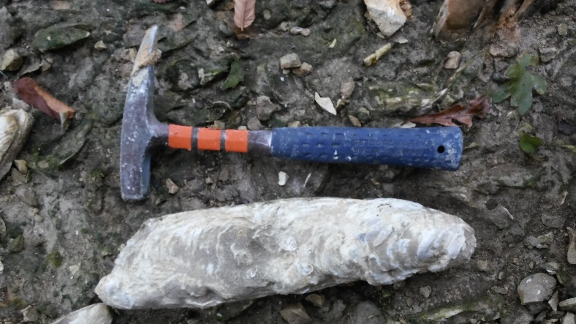
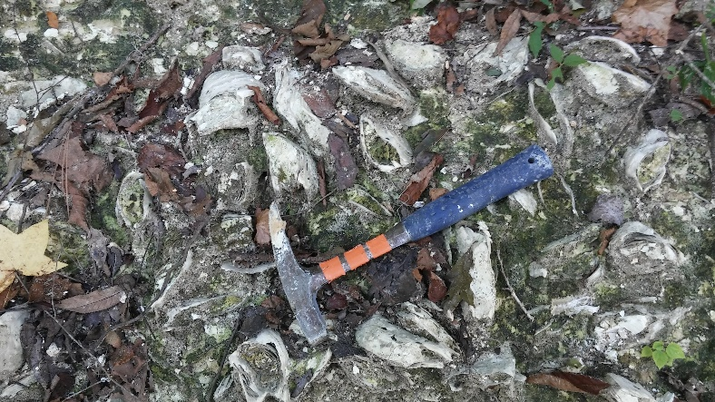
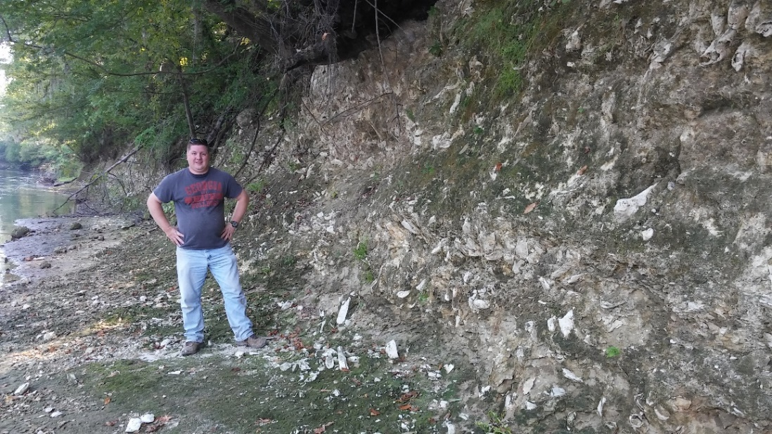
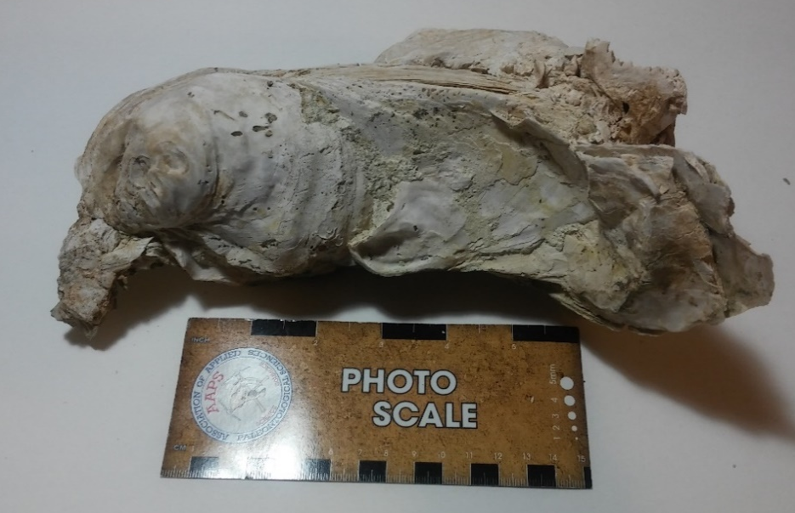
Crassostrea gigantissima
Yuchi Wildlife Management Area
Burke County, GA.
These Crassotrea giantissama lived about 34 million years ago.
The species is extinct but the members of the genus still exist as an important food source (Crassostrea gigas).
They live in the inter-tidal zone so they’re often exposed during low tide.
They do well in waters with a low nutrient supply.
As true oysters of the order Ostreoida they do not produce pearls.
Hank Josey,
VP Paleontology Association of Georgia

Slide 4
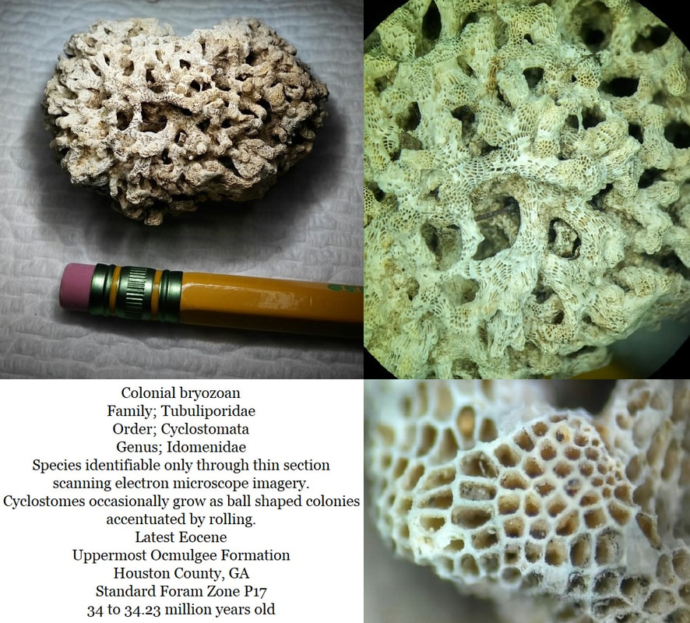
Amateur Discoveries Contributing to Science.
It’s the amateur’s boots which explore.
On a hilltop in Oaky Woods WMA Hank Josey and I found Cyclostomata colonial bryozoans.
It took a year to properly identify them.
Those “Beautiful Specimens” are being studied in four Southeastern natural history museums.
The Natural History Museum in London, where Charles Darwin’s collection is housed, has also requested samples of our superb specimens.

Slide 5
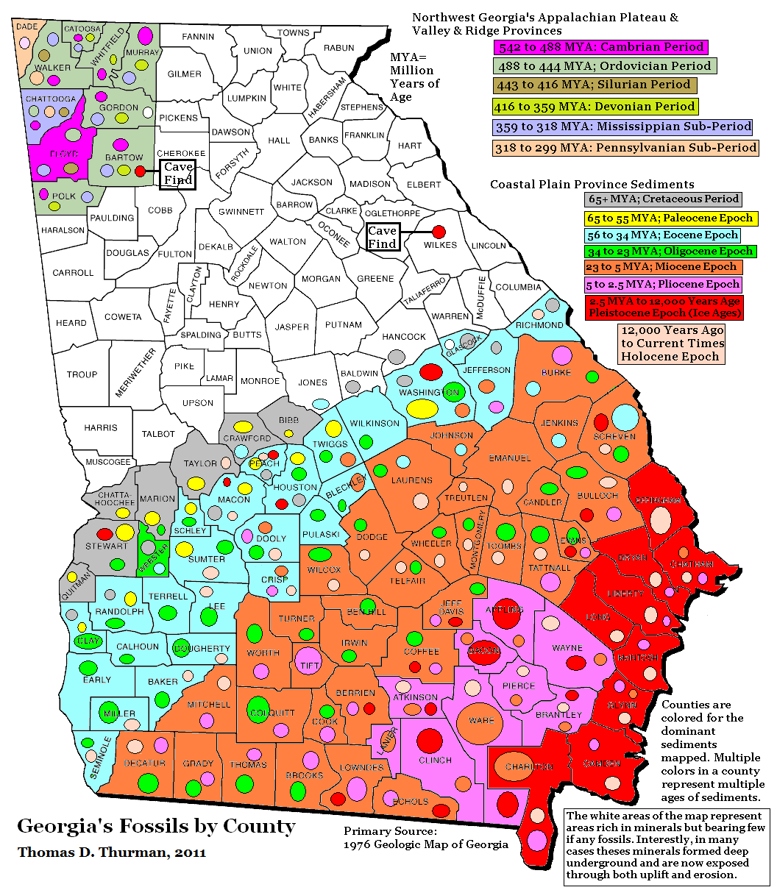
Georgia Fossil Map
by County
Our oldest fossils
occur in Northwest Georgia
Our most recent occur in Central & Coastal Georgia.
Taken Together
Georgia Teaches Us About:
Climate change
Evolution
Geologic time
Meteorites
Paleontology
Plate tectonics
Sea level change
Volcanoes

Slide 6
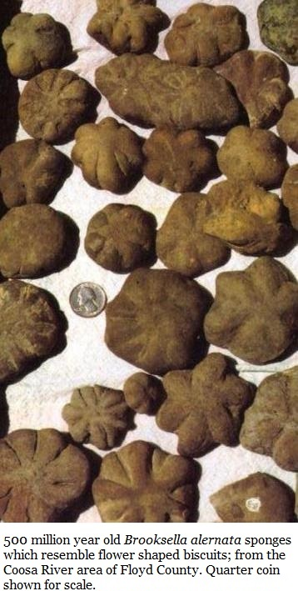
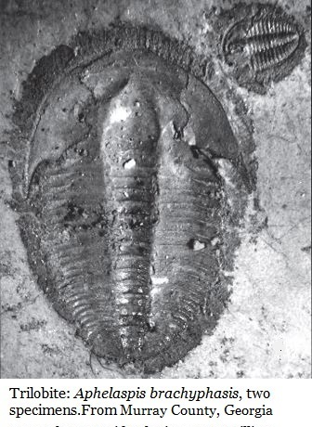
Georgia’s Oldest Fossils
500 million years ago
Researchers have studied trilobites and other fossils of northwest Georgia since 1884.
When these animals lived…
Georgia was in the Southern Hemisphere
There were no bones, enameled teeth, vascular plants, or insects anywhere on the planet.
The seas were full of life but terrestrial Earth was barren
.
Time:
Middle Cambrian

Slide 8
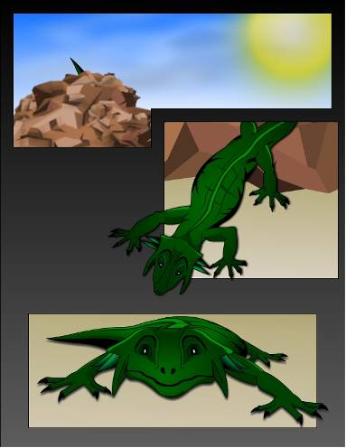
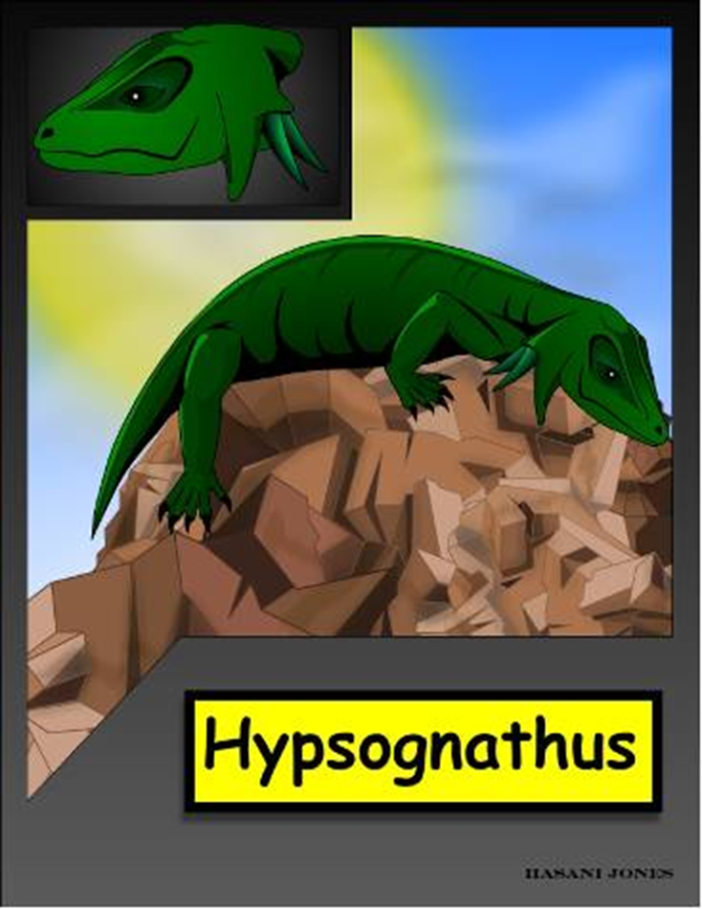
Dr. Tim Chowns at the University of West Georgia
reports that a Hypsognathus was discovered near Savannah in a drill core sample from more than 2,000 feet deep.
Time;
Upper Triassic
Hypsognathus about 12 inches long, lived about 200 million years ago.
It lived in a rift valley created when plate tectonics attempted, but failed, to open the Atlantic Ocean. Tectonics opened the Atlantic about 130 million years ago.

Slide 9
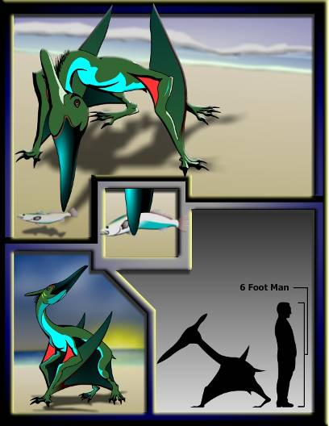
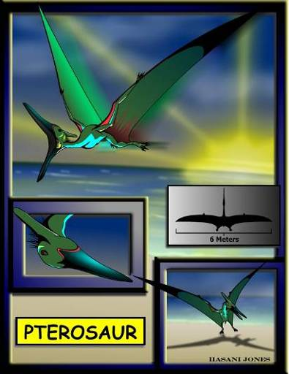
Pterosaurs flew over Georgia
83 million years ago.
Time;
Upper Cretaceous
In 1985 David Schwimmer, Kevin Padian, & Alfred Woodhead Reported pterosaur fossils from Fort Benning, GA.

Slide 10
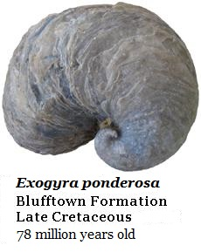
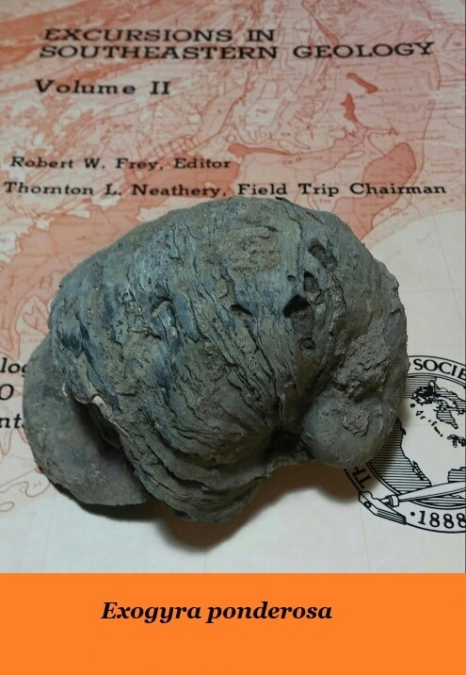
Exogyra ponderosa
Dinosaurs walked Georgia when these oysters lived.
Well known for over a century…
78 million year old Exogyra ponderosa oysters densely occur in 3 meters (10 ft) thick beds in West Georgia.
Time;
Upper Cretaceous

Slide 11
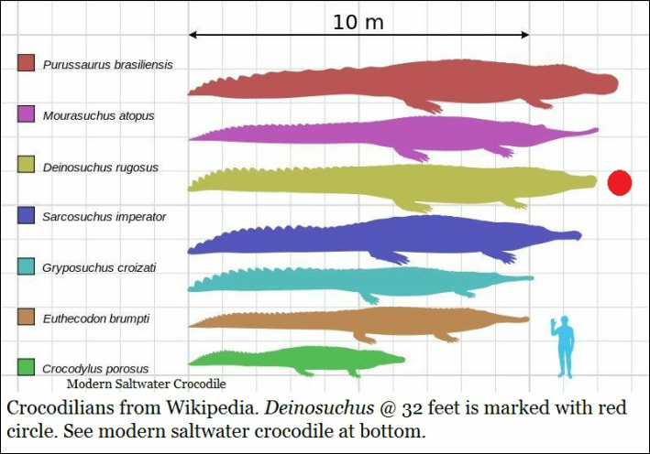
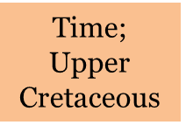
Deinosuchus; The Terrible Crocodile, has been deeply studied by Dr. David Schiwmmer at Columbus State University and is well known from Georgia’s Fossil Record
A dinosaur eating crocodile.
Populations occurred in Texas and Georgia, on both coast of the Western Interior Seaway.
Individuals on the Georgia side tended to be smaller, but populations were denser.
The giant crocs were more common in our area.

Slide 12
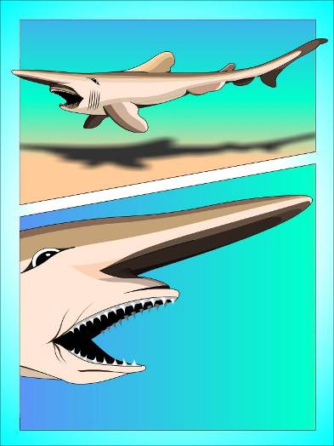
The goblin shark
Scapanorhynchus texanus
78 million years old
Georgia’s most common Cretaceous fossil.
Time;
Upper Cretaceous

Slide 13
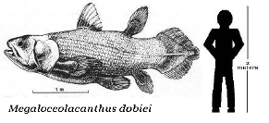
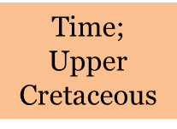
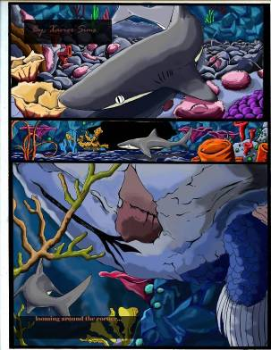
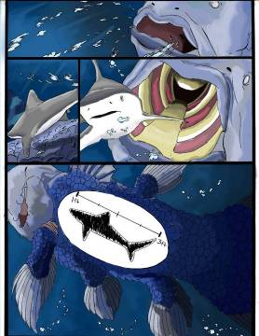
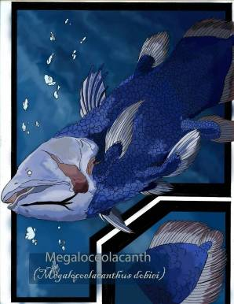
Megalocoelacanthus dobiei
78 million years olds
In 1994 David Schwimmer, J. D. Steward & Dent Williams described this new species.
New genus & species named from Georgia & Alabama fossils
In 1994 David Schwimmer, J. D. Steward & Dent Williams
described this new species.

Slide 14
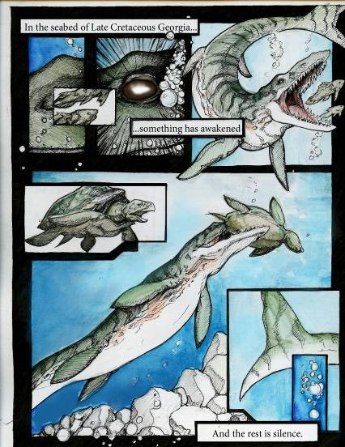
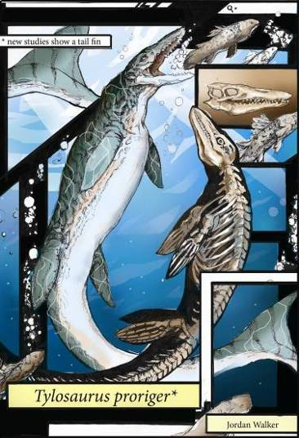
The mosasaur Tylosaurus hunted Georgia lost 78 million years ago.
Mosasaurs have been known from Georgia’s fossil record for more than a century

Slide 15
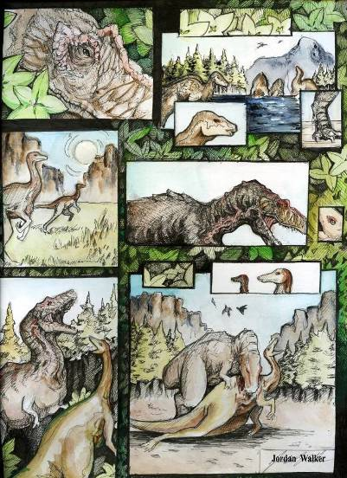
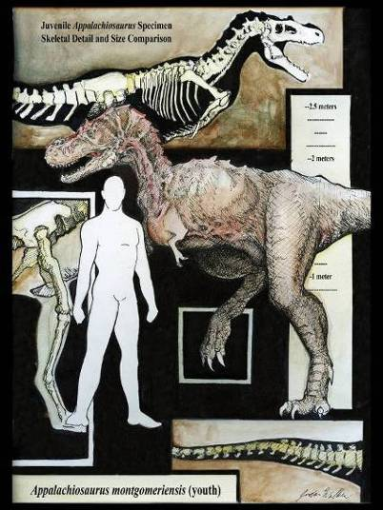
Appalachiosaurus montgomeriensis
78 million years ago
Illustration of an adolescent animal.
In 2005 Appalachiosaurus was described as a new species occurring in both Georgia and Alabama

Slide 16
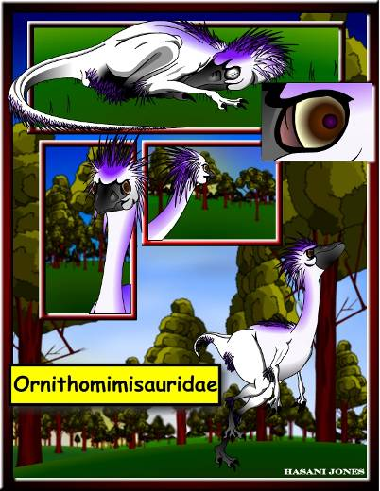
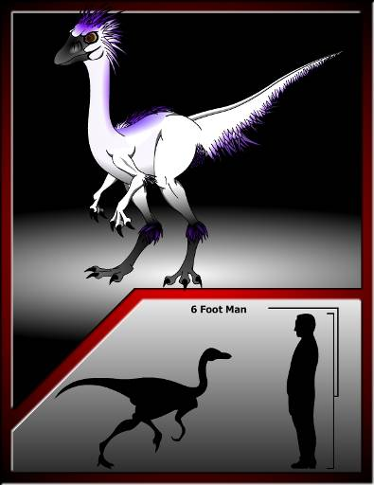
78 million years ago
Ostrich-like Dinosaurs
hunted Georgia.
Reported in 1993 by
David Schwimmer, J. Dent Williams, James Dobie & William Siesser,
these dinosaurs hunted Georgia

Slide 17
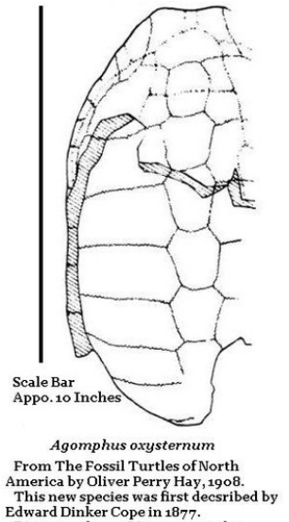
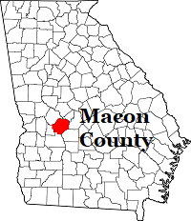
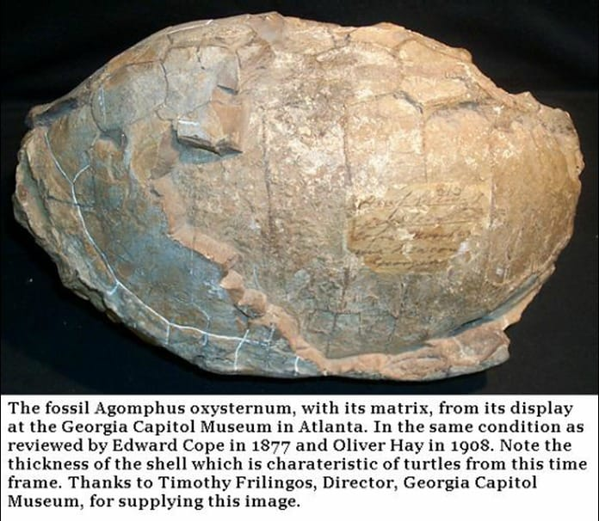
Agomphus oxysternum
A new species discovered in Montezuma, GA.
Described by the famous American paleontologist
Edward Drinker Cope
(July 28, 1840 – April 12, 1897)
On 20/July/1877 Edward Drinker Cope’s findings on this turtle were read at the proceedings of the American Philosophical Society, establishing the species.
Cope reports that the specimen was originally nearly complete but was damaged by “destructive curiosity hunters”.
The specimen originated in the 61 million year old Clayton Formation of Macon, County. Near Montezuma.
Note the thickness of the turtle’s shell. Pressures from predation “selected” a thicker shell’s greater protection. Thick shells are expensive, requiring a large percentage of the animal’s nutritional intake. The thin shell of modern turtles isn’t a liability since today’s predators are smaller and have less bite force.

Slide 18
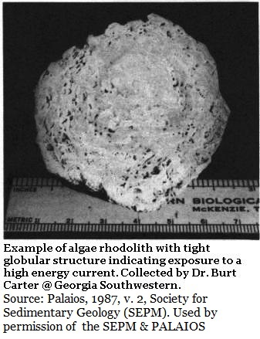
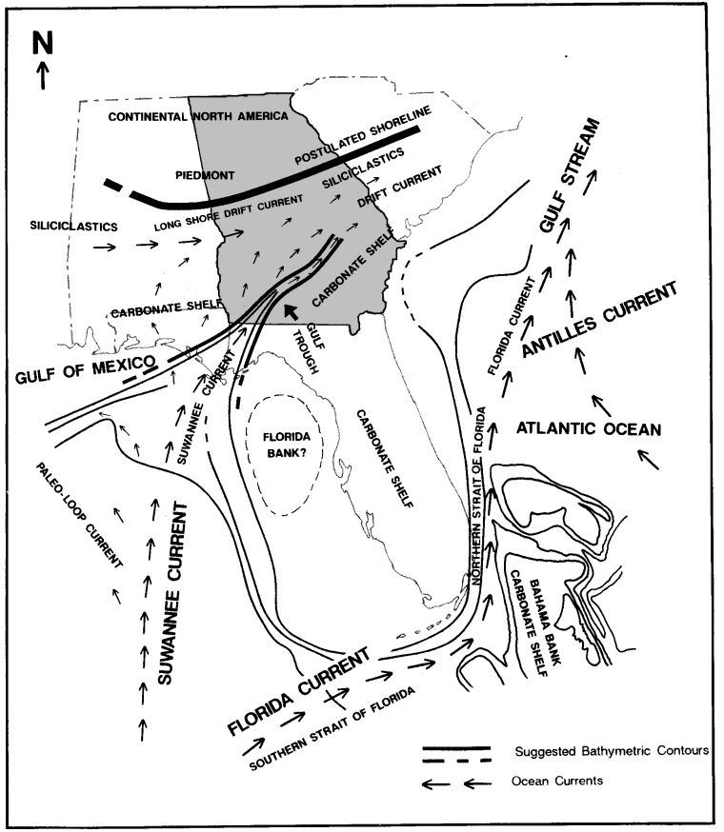
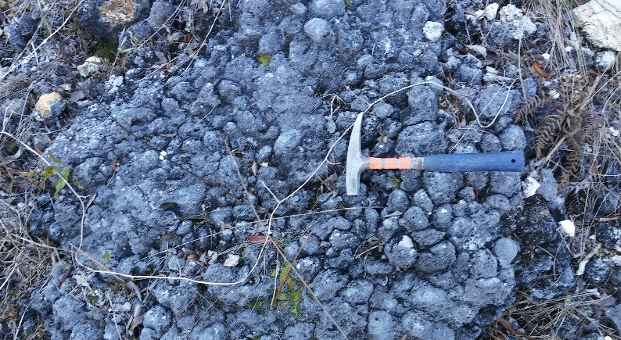
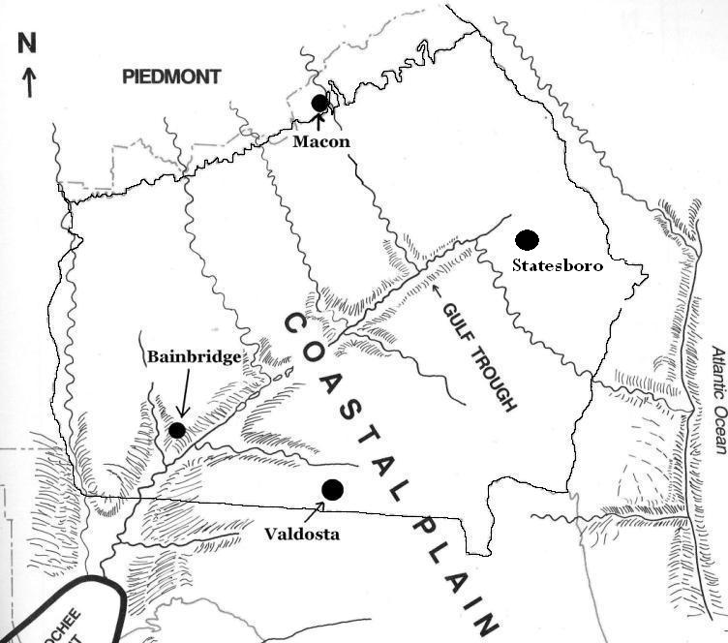
Suwannee Current & Gulf Trough
Research by Dr. Burt Carter at Georgia Southwestern revealed that for 40 million years a powerful current crossed the south Georgia, carving a vast trough, or canyon, which was completely buried by later large scale erosion.

Slide 19
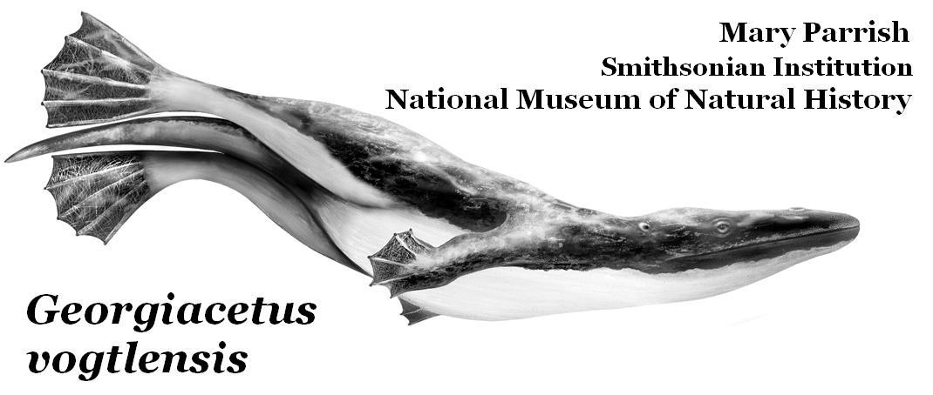
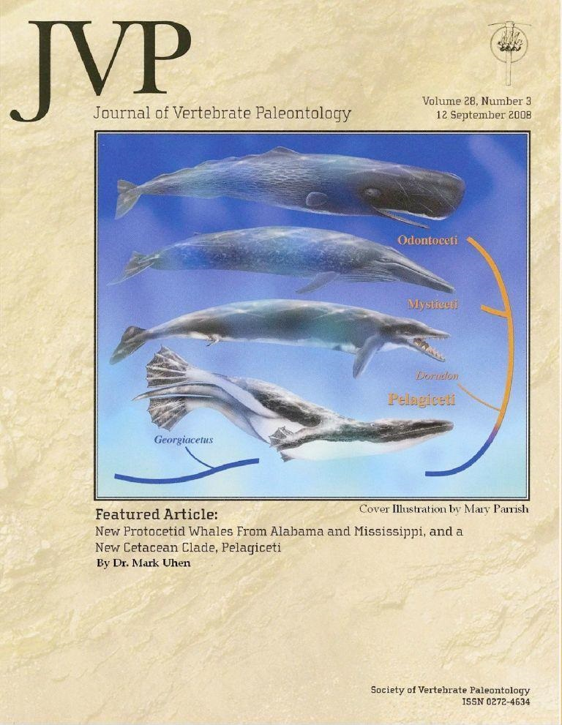
Georgiacetus vogtlensis (the Georgia Whale) is a new species named for a Georgia fossil. It lived 40 million years ago, is an evolutionary transition fossil and is likely the ancestor to all modern whales.
Time;
Middle Eocene
The skull and skeletal structure of Georgiacetus is almost identical to the later basilosaruids like Durodon.
Except for the tail, Georgiacetus lacked a fluke, flukes emerged with the basilosaurids who were the likely descendants of our Georgia Whale.
The fossils were discovered during the 1983 construction of Nuclear Power Plant Vogtle and described by Richard Hulbert. The fossils are on display at Georgia Southern Museum.

Slide 20
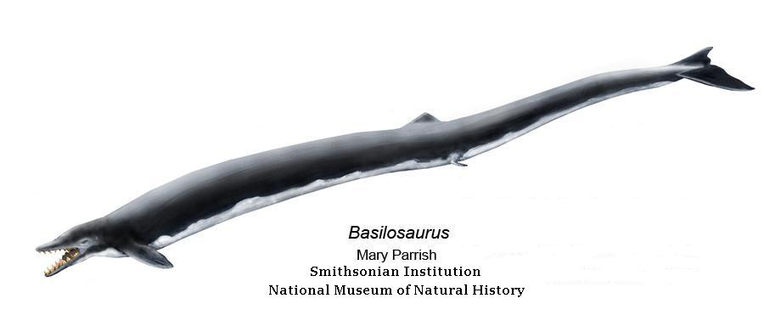
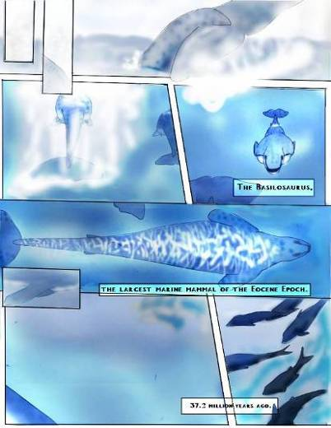
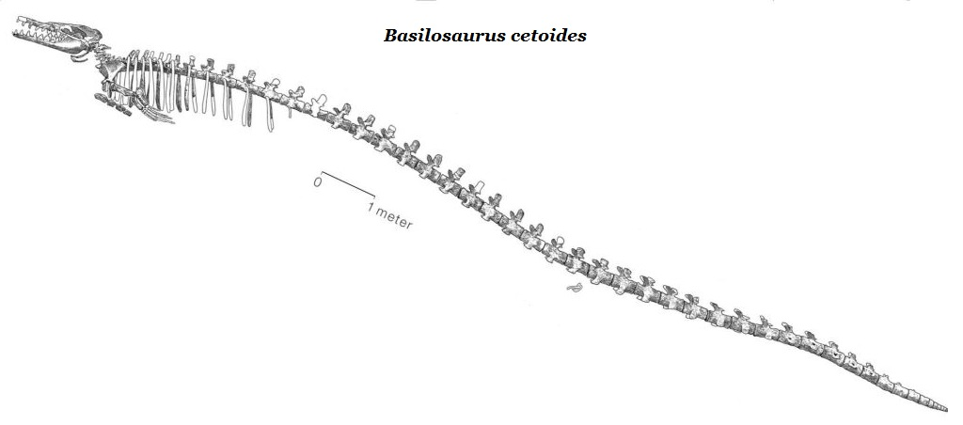
The family of basilosaurids are the first whales to posses flukes.
They’re well known from Georgia’s 37 million year old sediments.
Rear Legs Atrophied
Time;
Late
Eocene
The basilosaurids are thought to be directly descended from Georgiacetus
The basilosaurids are a large of whales ranging from dolphin sized to the first great whales.

Slide 21
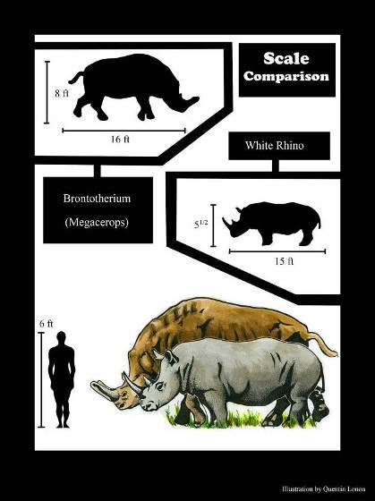
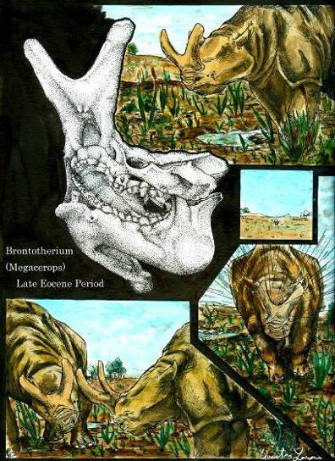
In 2005 Dennis Parmley and David J. Cicimurri reported a single brontothere tooth from sediments in Gordon Georgia.
Brontotheres walked Georgia
35 million years ago

Slide 22
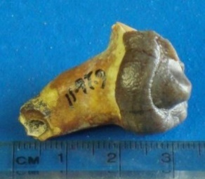
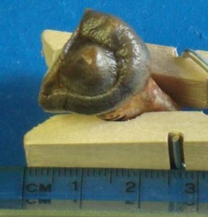
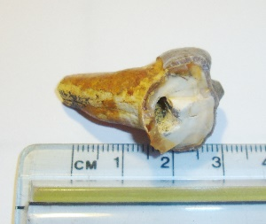
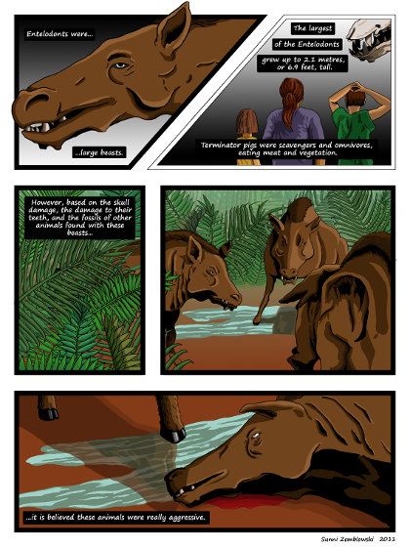
Terminator Pigs
(Entelodonts)
also walked Georgia 35 million years ago.

Slide 23
C. megalodon
The largest shark that ever lived is well known from Georgia.
Adults reached at least 52 feet in length, and may have exceeded 67 feet in length.
There is strong evidence that they actively hunted whales.
17.5 cm or (6.9”) megalodon tooth
Time: Miocene Epoch
13.5mm (5.3”) megalodon tooth &
great white shark teeth.

Slide 24
23.3 to 5.3 million years ago
Both megalodon and Scaldicetus, the Killer Sperm Whale,
are present in the sea which covered South Georgia.
Scaldicetus grew to nearly 23 feet.

Slide 25
Thecachampsa was known to reach 32 feet in length, it is reported in Georgia’s sediments dating between 23.3 to 5.3 million years ago.
.
Time;
Miocene Epoch

Slide 26
In this same time frame, rhinos walked Georgia.
Not enough fossils were found for identification to the level of genus, but Teleoceras is confirmed & common in Florida

Slide 27
The Terror Bird Titanus walleri, very likely occurred in Georgia during the Pliocene, it is known from Mexico, Texas & Florida, but fossils have yet to be confirmed in the Peach State.
Terror birds &
Three-Toed Horses
Terror birds likely hunted the Hipparion horse which was common in Florida & Georgia during the Pliocene. Known as the three-toed horse, two of the horse’s toes didn’t reach the ground so it walked on a single toe per foot like modern horses.

Slide 28
Most recently; we have Pleistocene Fossils
The modern gray whale, Eschrichtius robustus,
occurs in Georgia’s Pleistocene or Ice Age sediments.
Time;
Pleistocene Epoch

Slide 29
The Pleistocene saw several ground sloths in Georgia including Eramotherium laurillardi which
stood more than 20 feet tall on its hind legs.
There’s no reason to believe any of our sloths were particularly slow

Slide 30
In 2006 Dr. Al Mead at Georgia College showed that herds of giant bison walked Georgia 21,000 years ago, several individuals were reported in a single find near Brunswick.

Slide 31
Ice Age mammoths also walked Georgia. Columbian mammoths were originally named from a Georgia fossil by the Scottish Paleontologist Hugh Falconer. During Sir Charles Lyell’s 1846 Georgia visit. He was given a fossilized tooth by Hamilton Cooper which had been discovered during canal work in the Brunswick, Georgia area.
Lyell passed the tooth to Hugh Falconer, who used it to establish the species Mammuthus columbi; the Columbian Mammoth.

Slide 32
At 17,000 years ago we have both the Columbian Mammoth and Humans,
the Clovis People, in Georgia
And while this is still the Pliestocene; we are approaching the Holocene Epoch which began 11,650 years ago; the time of human domination of the world.

Slide 33
See Facebook
for both
Georgia’s Fossils Group
&
Paleontology Association of Georgia
From trilobites, through dinosaurs, the origins of whales, and on to mammoths….
Georgia’s fossil record is deep, rich, and diverse.
It’s almost unknown by our students, parents & teachers.

