Slide 1

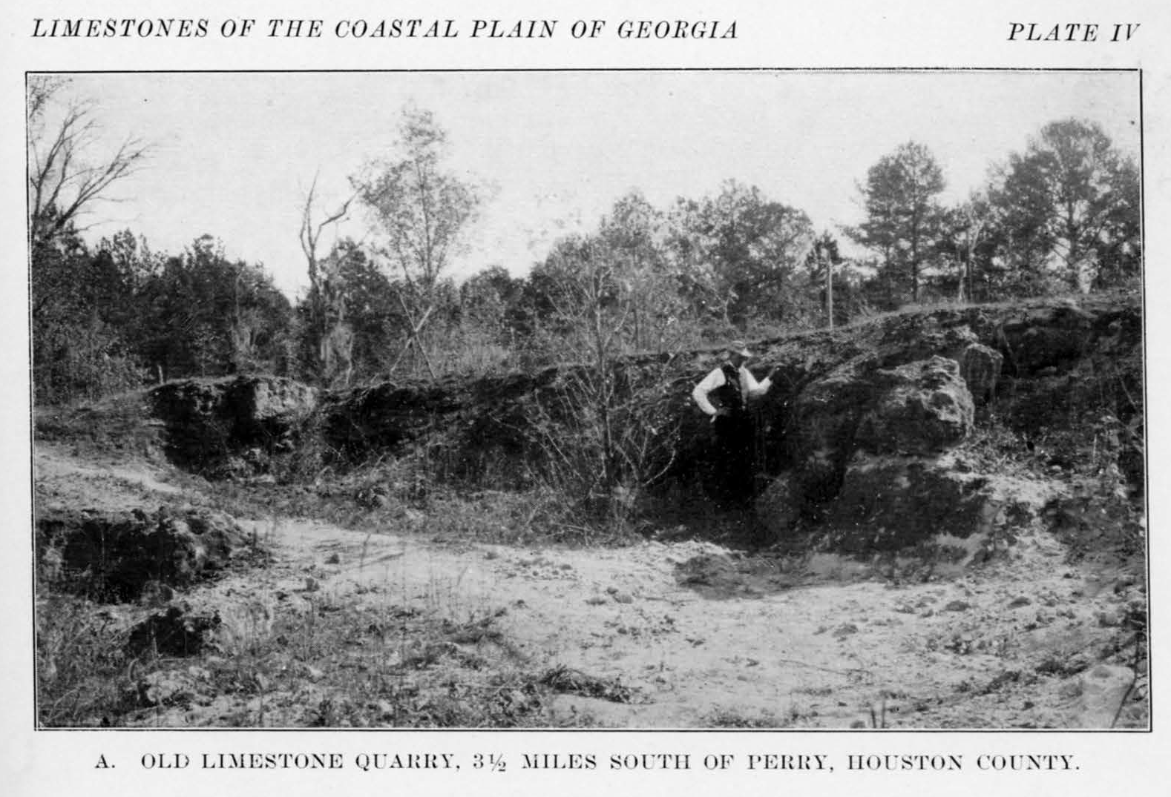
Houston County, Georgia
More Than A Century of Paleontology
This Georgia Science is unknown
to our
science teachers.
Teachers cannot teach what they do not know.
Left;
The Old Houston County Tivola Limestone quarry included in the 1917 research report from the Georgia Geologic Survey.

Slide 2
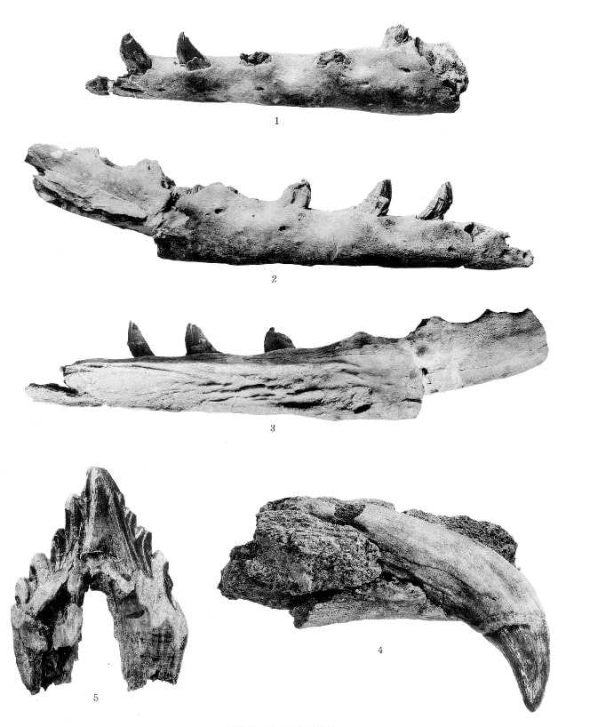
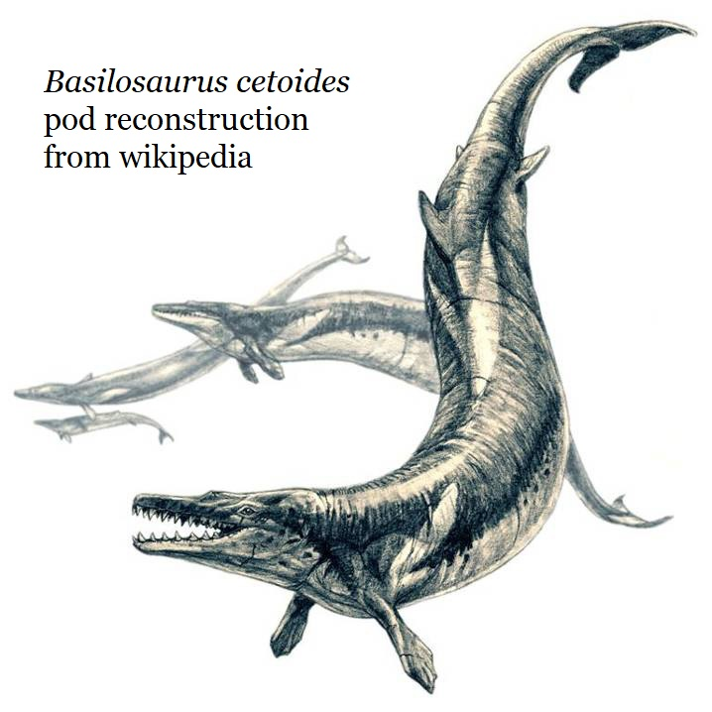
The Whales of Houston County; Georgia
In September of 1932 workers in a Houston County limestone mine discovered a 35-million-year-old Basilosauris cetoides whale in the cliff walls.
Basilosaurus cetoides was the first great whale species and ranged from 15m to 20m (49 to 66 feet).
Professor Leon P. Smith of Wesleyan College was contacted, and he recovered the material.
Smith recovered 23 vertebrae, several head bones, two large pieces of mandibles with teeth and a large box full of partial rib bones; the Houston Home Journal and Macon Telegraph both reported on Smith’s work.
Source; A Review of Archaeoceti,
Remington Kellogg, 1936

Slide 3
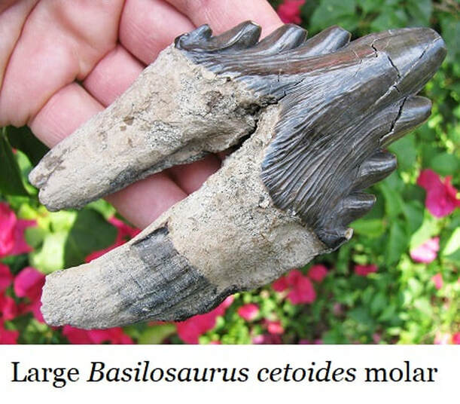

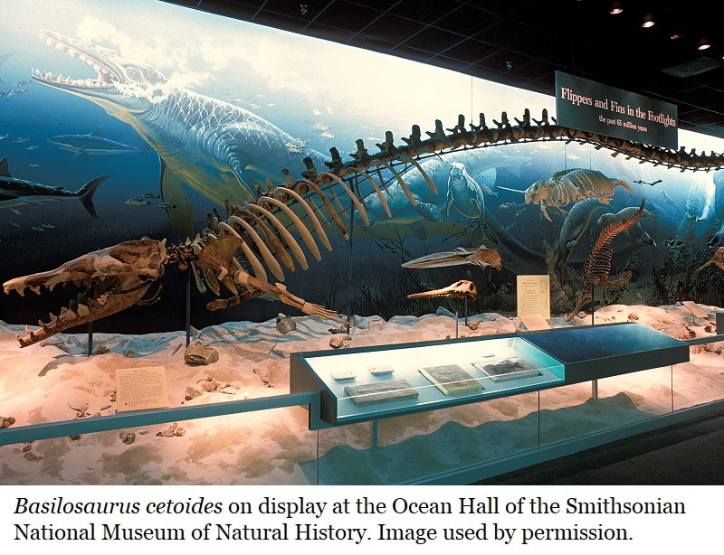
Neither Houston County Public Schools
nor Wesleyan College
preserve this record in their current curriculum, nor seem aware of this local history.
The specimens ended-up being donated to the Smithsonian National Museum of Natural History.
The Houston County specimens became part of Remington Kellogg’s famous 1936 study of whale evolution; “A Review of Archaeoceti”.
They were finally included in the reconstruction of the whale shown to the right and even today they grace the Hall of Oceans in the Smithsonian National Museum of Natural History.

Slide 4
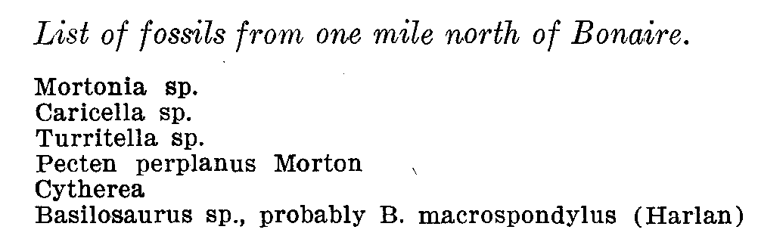
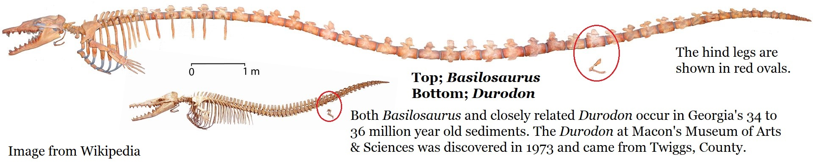
The 1932 report is not
Houston County’s
oldest whale discovery.
In 1911 researchers Veatch & Stephenson
reported a Basilosurus macrospondylus (later re-assigned as Basilosaurus cetoides) from Bonaire, Georgia; also in Houston County.
This is another individual of the same the same species, same approximate age, in the same Tivola limestone.
This is just north of the modern intersection of Hwy 247 & Hwy 96.

Slide 5
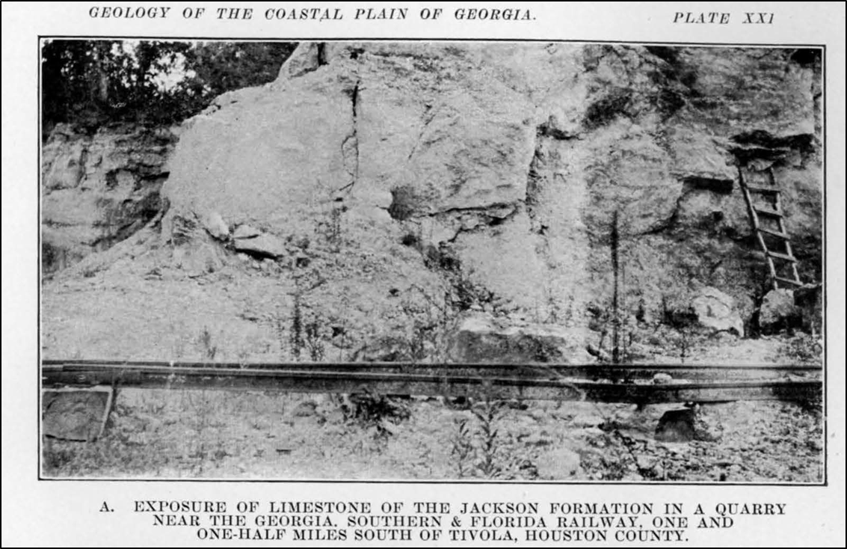
Houston County’s
Fossil Rich Tivola Limestone
This image is from page 297 of Veatch & Stephenson’s 1911 report.
Their Jackson Formation was reassigned in 1986 as the Tivola Limestone Formation.
The Tivola Limestone has been actively mined in Houston County for more than a century & was named for the Tivola Railroad Station
The extinct Village of Tivola was just south of Perry, very near the current Perdue Plant.

Slide 6
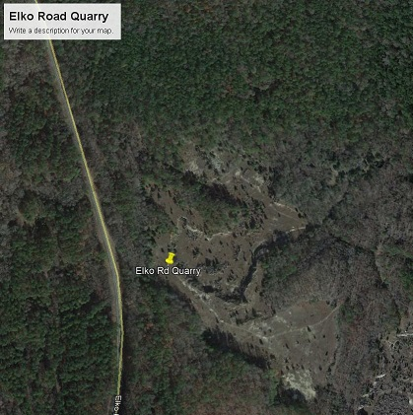
Houston County’s quarries
were already old a century ago
left; The Perry-Elko Road Quarry was described as “old” by Veatch & Stephenson in 1911.

Slide 7
A politician recently asked me;
“How do you know it’s 35 million years old?
What if it’s 6,000 years old?”
Because Science is like Sports;
Both are very good at regulating themselves.
If an athlete or team begins cheating or behaving poorly;
teammates, competitors or officials bring them back in line.
So too with Science; that’s the power of Peer Review;
If a researcher wanders away from the discipline,
And begins insisting on things which just aren’t true,
They’re quickly shunned or brought back in line by their peers.
After more than a century of research,
there’s been few significant variations in dating Georgia’s sediments.
Sure, small adjustments and corrections have been made,
But generally the dates have stood the test of time.

Slide 8
Our Earth Science is not taught in our
Public Schools.
But this problem extends far beyond
Houston County, it’s sadly common across Georgia.

Slide 9
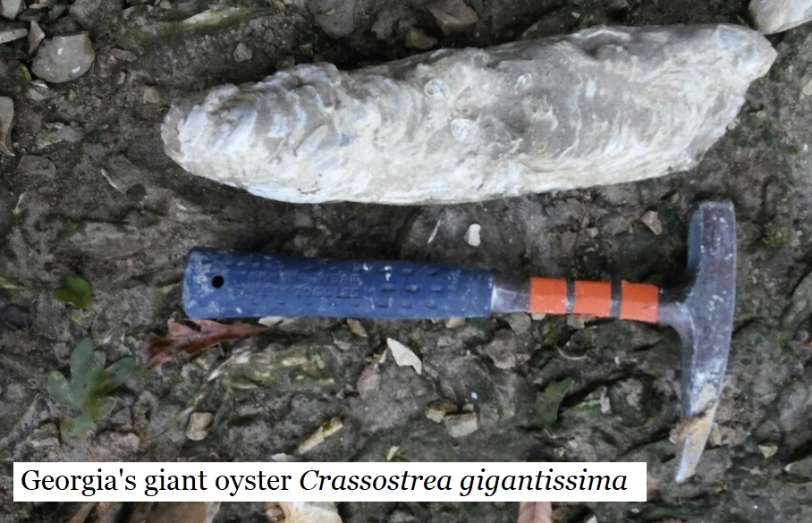
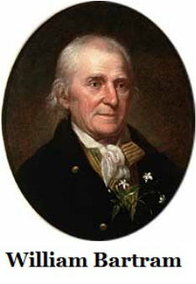
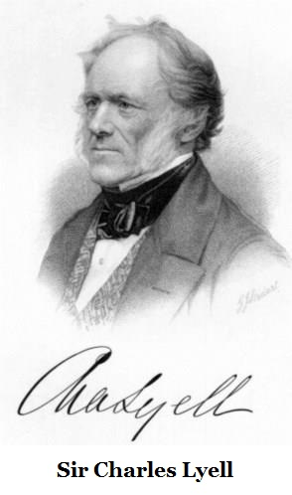
Georgia’s first paleontological observations were made in 1765 at Shell Bluff in
Burke County, Georgia.
William & John Bartram made Georgia’s paleontological observations in 1765 when the visited the “Curious phenomenon” of many fossilized giant oysters (up to 56cm or 22” long) at Shell Bluff along the Savannah River and reported this their 1791 book Bartram’s Travels.
Sir Charles Lyell; the Father of Modern Geology, visited the USA twice and travelled Georgia in 1842. He spent three days along the Savannah River collecting and studying the beds of these oysters. Lyell is the famous mentor and advisor to Charles Darwin. Lyell authored the book Principles in Geology (first published in 1830) which Darwin studied during his HMS Beagle journey. Darwin & Lyell met upon Darwin’s return to England and Lyell befriended Darwin.

Slide 10
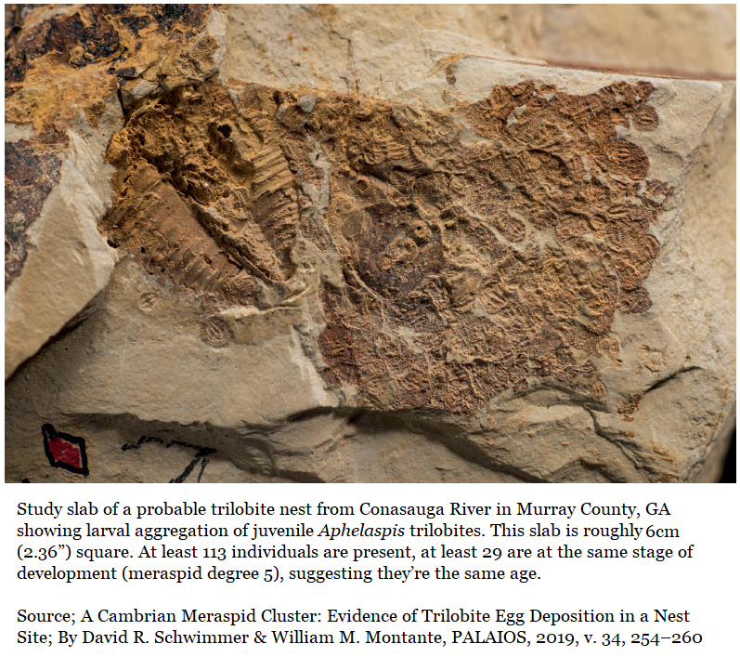
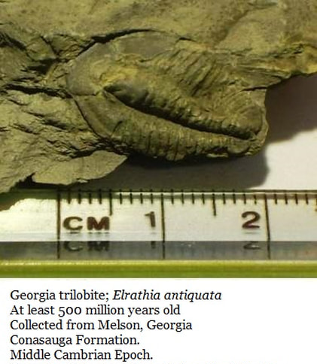
Northwest Georgia’s Trilobites
Have been studied for 130+ years, yet few science teachers are aware of them.
In Northwest Georgia… As early as 1884 Charles Doolittle Walcott, a famous American invertebrate paleontologist, published research papers describing Georgia’s 500-million-year-old trilobite specimens.
The science continues; in 2019 David Schwimmer & William Montante published research on NW GA trilobites which has global importance in understanding trilobite behavior.

Slide 11
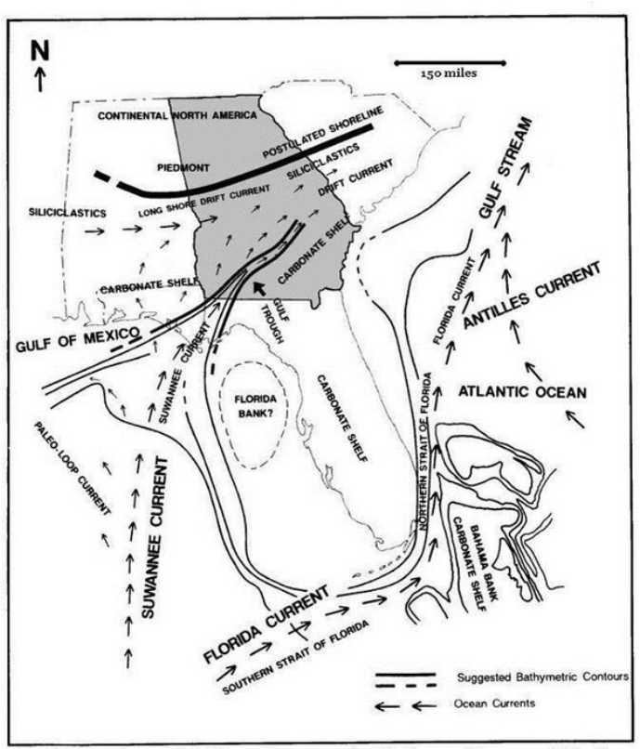
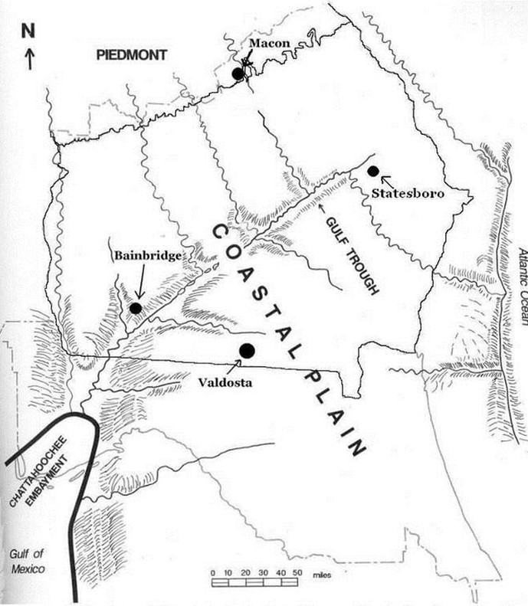
The Gulf Trough & Suwannee Current
In 1987 invertebrate paleontologists Paul Manker & Burt Carter of Georgia SouthWestern used algae fossils to confirm the presence of a great canyon across Southwest Georgia.
Suspicions had been raised by the geologist team Paul & Ester Applin in 1944 that such a canyon existed.
Even Veatch & Stephenson in 1911 reported the possibility.
In 1993 Paul F. Huddlestun extended the research of Manker & Carter, recognizing that this was a world class geologic feature which endured for tens of millions of years through many dramatic sea level shifts.

Slide 12
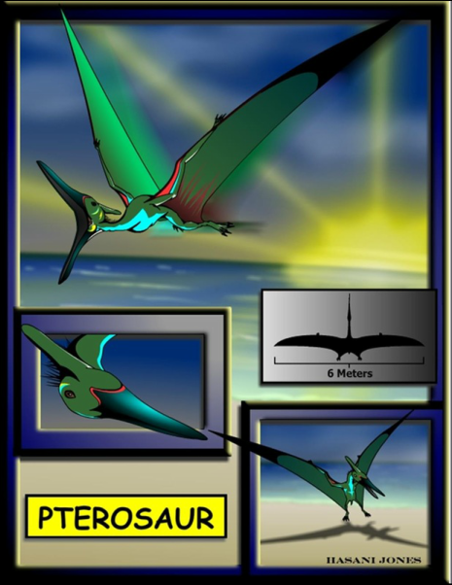
Georgia’s Pterosaurs
Flying reptiles are rare everywhere but were unknown in Georgia until May 1985, when David Schwimmer from Columbus State University, Kevin Padian from University of California in Berkley and Alfred Woodhead from Martin Army Hospital at Fort Benning, Georgia collaborated to share this unique discovery.
83 million years ago pterosaurs flew through Georgia’s skies.

Slide 13
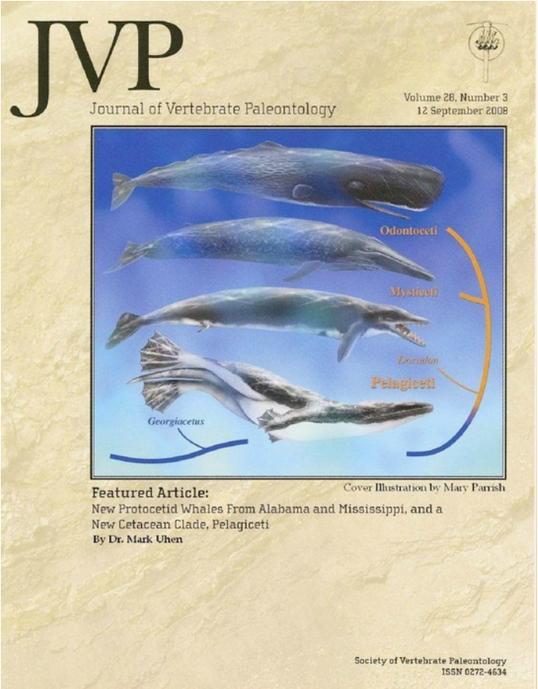
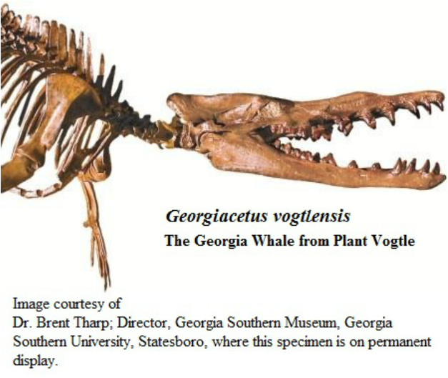
A Whale just for Georgia; Georgiacetus vogtlensis
During the 1983 construction of Nuclear Power Plant Vogtle in Burke County, crews revealed a large mass of fossilized bones. Dr. Richard Hulbert led the Georgia Southern team which described what proved to be a new genus and species of early whale; it was named Georgiacetus vogtlensis (The Georgia-whale from Plant Vogtle.)
In 2008 Mark D. Uhen made of cover of the prestigious Journal of Vertebrate Paleontology with a paper showing that Georgiacetus swam with its hind legs and possibly led to all modern whales.

Slide 14
Georgia is the source
of so much superb Earth Science,
Sadly, very little of it finds
Public school classrooms.
Teachers cannot teach what they do no know.
Write your
State Representative or State Senator
in Atlanta.
Our children should become Georgia’s next explorers.

Slide 15
References
Pre-Historic Whale Bones Found In Mine Near Perry; Houston Home Journal, Perry, GA, Thursday, 8/Sept/1932, Reprint from The Macon Telegraph (No author credited)
Perry Whale Fossil Only One of Kind in N. America, Houston Home Journal, Perry, GA, Thursday, 3/November/1932 (No author credited)
Veatch, Otto & Stephenson,Lloyd Williams; Preliminary Report on the Geology of the Coastal Plain of Georgia,, Bulletin 26 of the Georgia Geologic Survey, 1911.
Kellogg, Remington; A Review of the Archaeoceti,, Carnegie Institution, Pub. 20, Published 1936.
Huddlestun, Paul F. & Hetrick, John H; Upper Eocene Stratigraphy of Central & Eastern Georgia, Bulletin 95, Page 24, Georgia Geologic Survey, 1986
Voss, Manja; Antar, Mohammed Sameh M.; Zalmout, Iyad S.; Gingerich, Philip D.; Stomach Contents of the Archaeocete Basilosaurus isis; Apex Predator in the Oceans of the Late Eocene:; Jan 9, 2019 in the online journal Plos One
Manker, J.P. & Carter, Burt; Paleoecology and Paleogeography of an Extensive Rhodolith facies from the Lower Oligocene of South Georgia and North Florida; Society for Economic Paleontologists and Mineralogists (Now the Society for Sedimentary Geology) Palaios,Vol.2, pg. 181-188. 1987
Huddlestun, Paul F. The Oligocene, A Revision of the Lithostratigraphic Units of the Coastal Plain of Georgia. Georgia Department of Natural Resources, Environmental Protection Division, Georgia Geologic Survey, Bulletin 105. 1993.
Hulbert, Richard C., Petkewich, Richard M. Jr., Bishop, Gale A., Bukry, David and Aleshire, David P.; A New Middle Eocene Protocetid Whale (Mammalia: Cetacea: Archeoceti) and associated Biota From Georgia. Journal of Paleontology, Vol.72, No.5, 1998. The Paleontological Society
Uhen, Mark D.; New Protocetid Whales from Alabama and Mississippi, and a New Cetacean Clade, Pelagiceti. Journal of Vertebrate Paleontology. Vol. 28, No.3, September 2008, Society of Vertebrate Paleontology.

