Slide 1
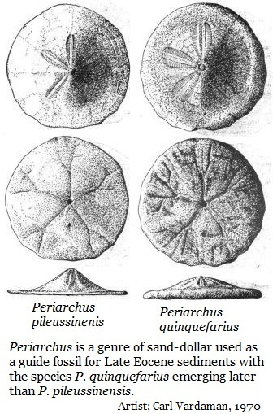

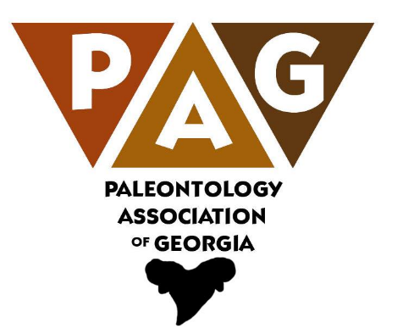
Georgia’s Fossils
Thomas Thurman
Author,
Amateur Paleontologist,
& Natural Historian
Hank Josey
Vice President
Paleontology Association of Georgia
& Natural Historian

Slide 2
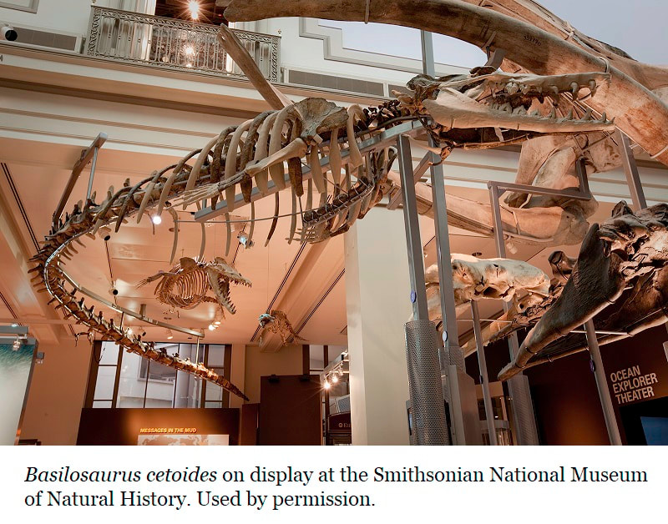
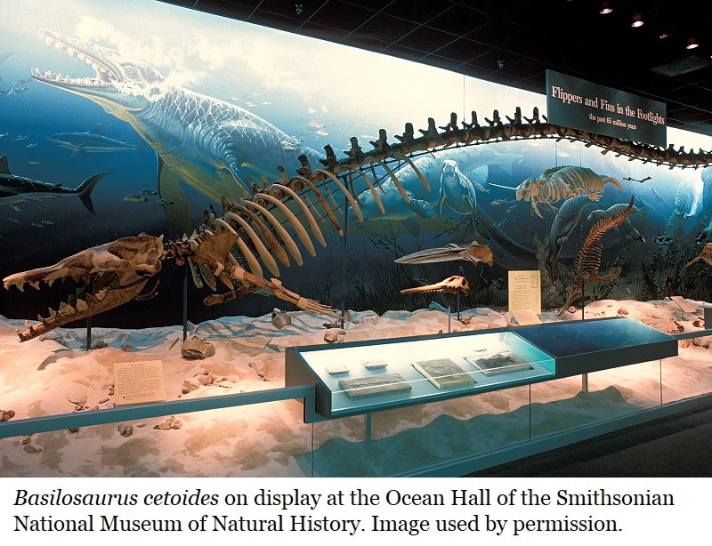

35 million year old
whale fossils displayed in the
Smithsonian
National Museum of Natural History
in Washington DC.
These skeletons were assembled from the bones of many whales, including fossils from here in
Houston County, Georgia.
Ms. Yoland Young, from here in the Perry Branch of the Houston County Public Library, helped me track down this story.

Slide 3
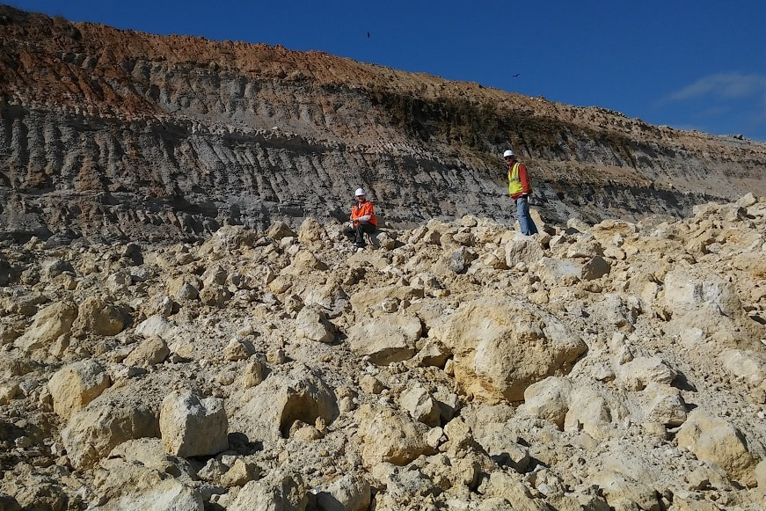
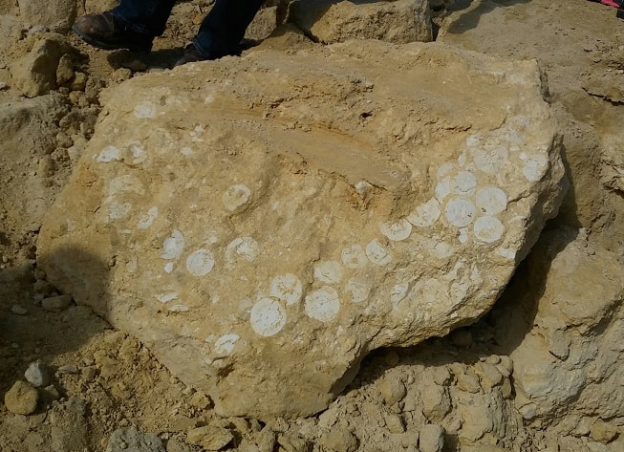
In September of 1932 miners lit the fuse to explosives and blasted a wall of the Tivola Limestone.
When the dust settled, the men began sorting through the fresh boulders when the bones of a monster emerged.
This mine is still in operation in Clinchfield, GA, about 7 miles southeast of the Perry library.
In 1932 it was named
Georgia Lime Rock Company.
Today it’s Cemex.

Slide 4
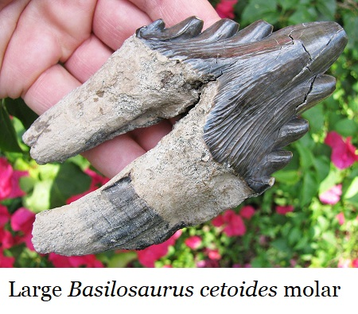
It was a fearsome beast with terrible teeth.
Great spikes for incisors and shearing, serrated blades for molars.
Source;
A Review Of The Archaeoceti
By Remington Kellogg
1936
The miners had revealed fossils of a
Basilosaurus cetoidethe Earth’s s, first great whale.

Slide 5
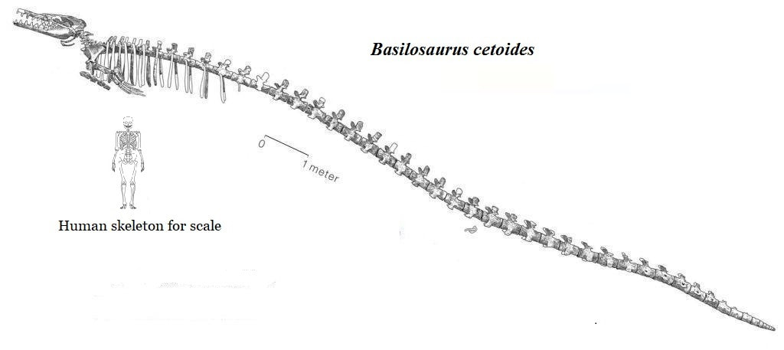
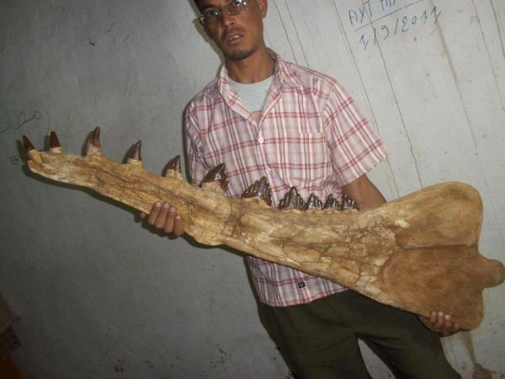
Basilosaurus cetoides
Reconstruction with human skeleton for scale.
Basilosaurus cetoides was set up as a species by Richard Owen in 1839 and is well known from both the Southeastern USA and Egypt. It’s the state fossil of both Mississippi and Alabama.
Basilosaurus mandible from Egypt.
The Tivola Limestone which occurs in Houston County and produced this whale, is roughly 35 million years old.

Slide 6
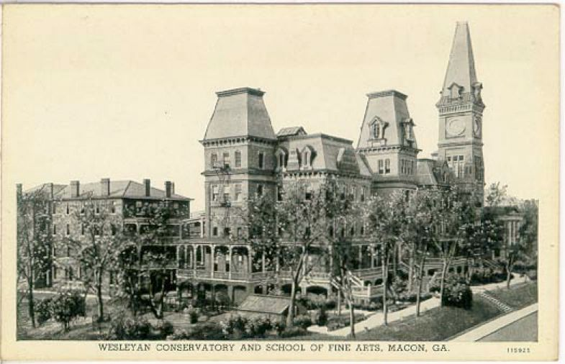
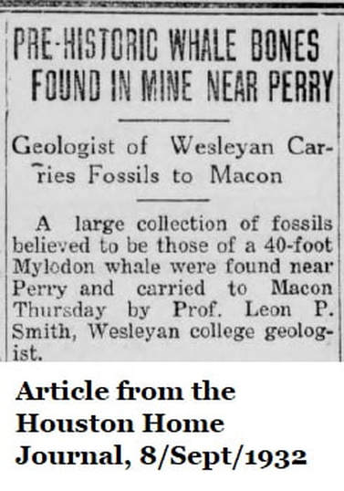
Georgia Lime Rock contacted
Leon P. Smith,
Professor of Geology,
at Wesleyan College.
Professor Smith visited the quarry and recovered 23 sections of vertebrae, several head bones, two large pieces of jawbones with teeth and a large box full of fractions of rib bones.

Slide 7
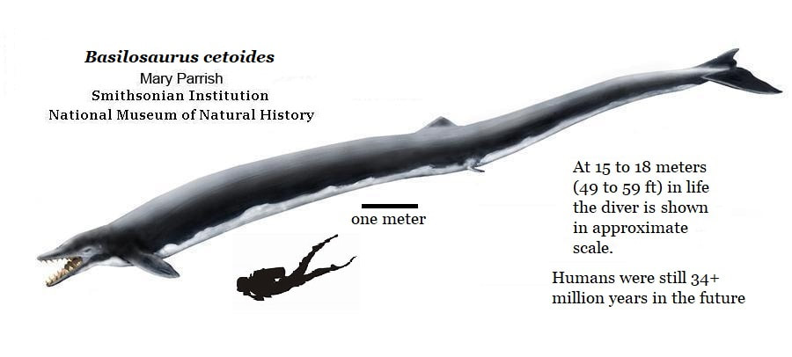
Basilosaurus cetoides
The living whale was 40 to 50 feet long.
This quarry with its whale fossils,
shark teeth, sand dollars, and sea shells is 150 miles inland.

Slide 8
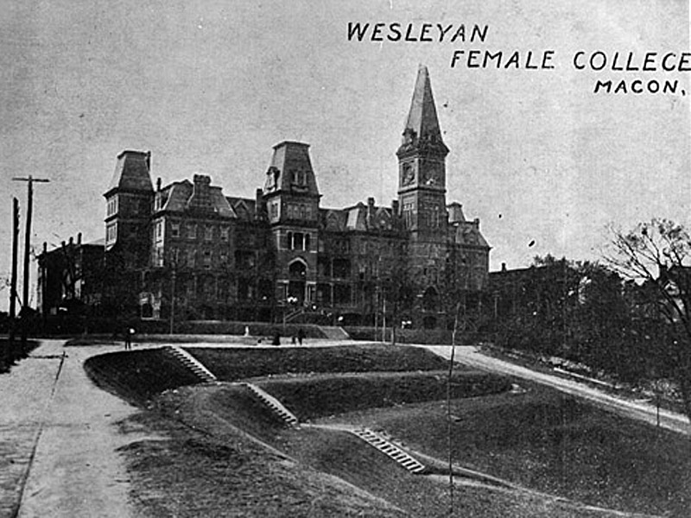
Professor Smith hoped to assemble the skeleton and display it in the Wesleyan Museum.
In the end, the fossils were donated to the United States National Museum under the care of Remington Kellogg.
The United States National Museum later became the Smithsonian

Slide 9
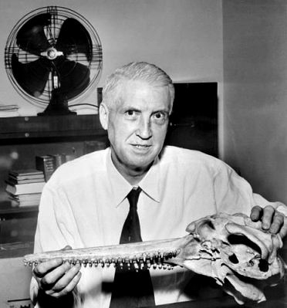
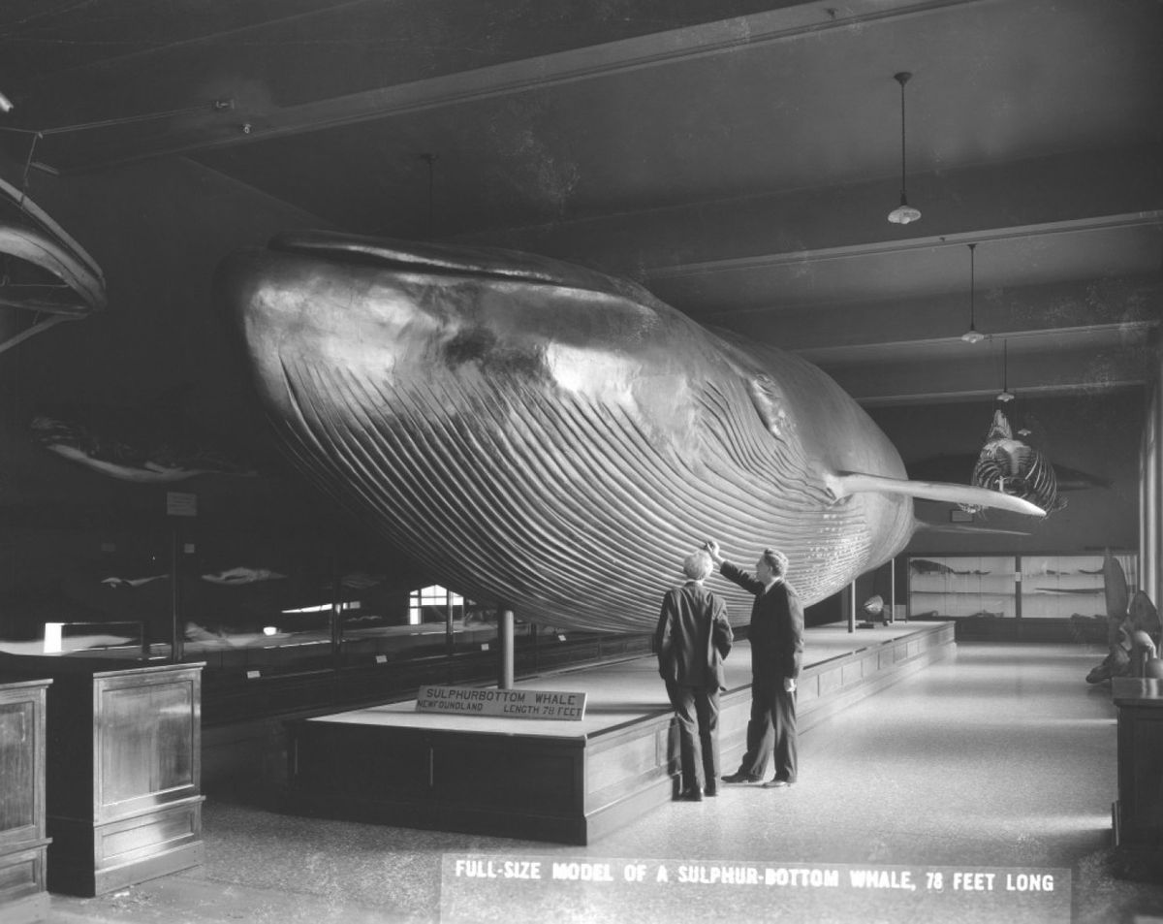
In 1928 Remington Kellogg became the assistant curator at the United States National Museum.
That same year he published
The History of Whales - Their Adaptation to Life in the Water
this paper established him as an expert
on the natural history of whales.
In 1936 he published
A Review of Archaeoceti and our own Houston County whale was included.
Full sized blue whale model once on display at the National Museum of Natural History
Remington Kellogg 1892-1969
In 1937 he was a US delegate to the International Conference on Whaling which led to the first hunting protections for whales.
He became curator of National Museum of Natural History in 1942.

Slide 10
The Houston County whale fossils as photographed on page 397 (Plate 8) of Kellogg’s 1936 paper.
This excellent report is still used in research over whale fossil identification and evolution.

Slide 11
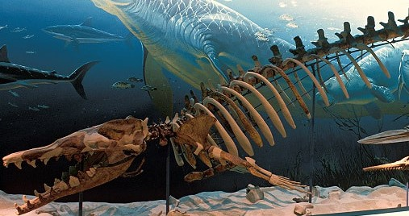
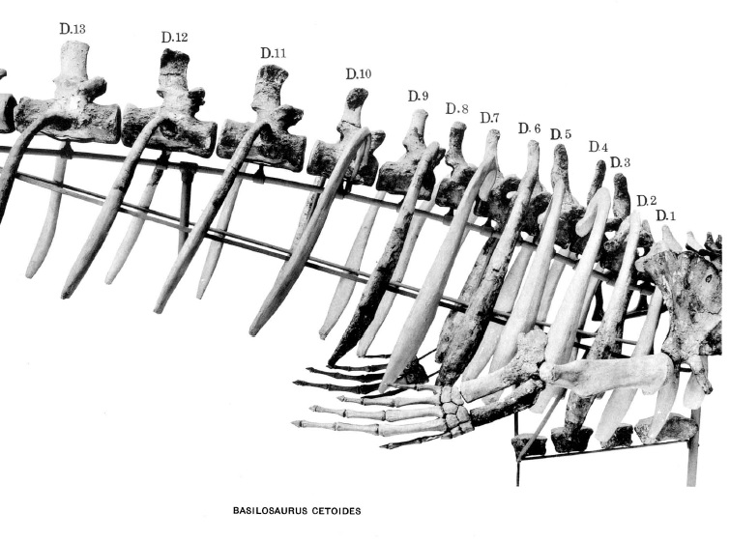
Comparison of 1936 reconstruction published by Kellogg in
A Review of Archaeoceti
& the modern reconstruction on display at the Smithsonian NMNH.
The specimen is adjusted at need to reflect advancing knowledge, but Kellogg’s original work is evident.
The fossils discovered in Houston County whale included 23 sections of vertebrae, skull bones, partial jaws, teeth and rib fragments.
Kellogg incorporated some of these into his 1936 reconstruction and they remain on display today.

Slide 12
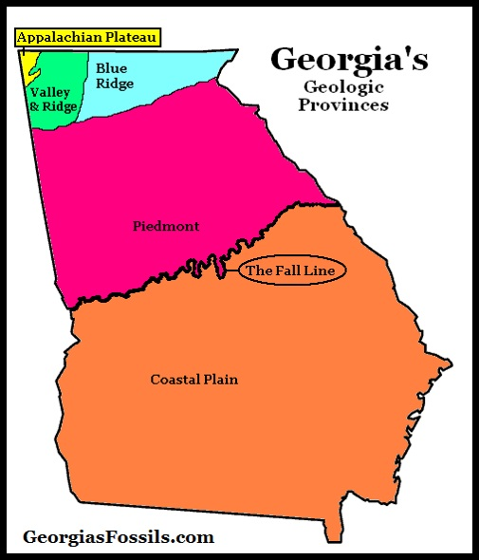
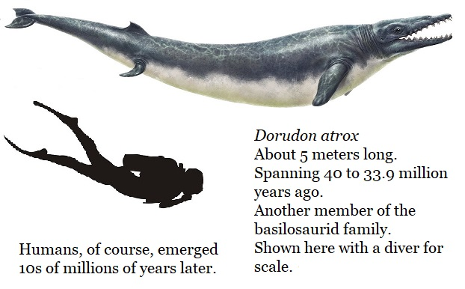
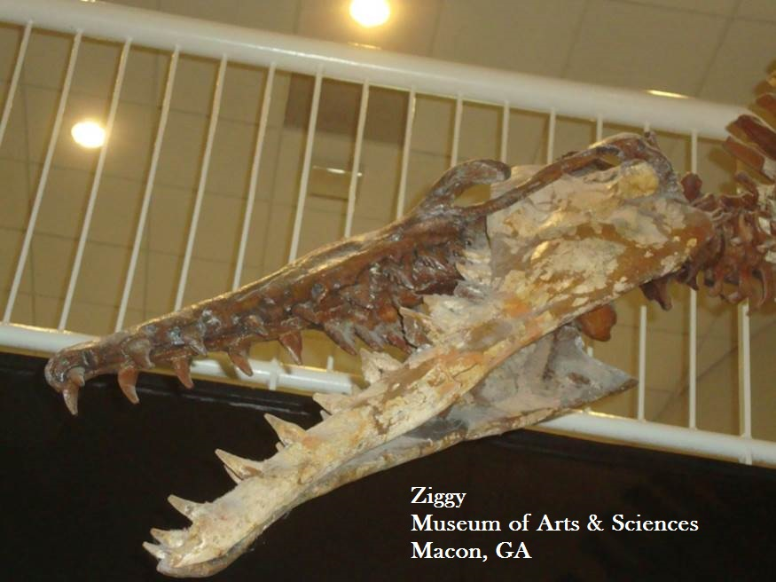
Georgia’s Coastal Plain is well known for whale fossils.
In 1973 amateur Bill Christy and his son Billy discovered Ziggy, the Dorudon serratus, on display at the Museum of Arts and Sciences in Macon, GA.
It came from Twiggs County, about 23 miles northeast of Perry and is younger than the Perry whale, Ziggy lived 34.35 million years ago.
But the Twiggs County & Houston County whales are closely related.

