Slide 1
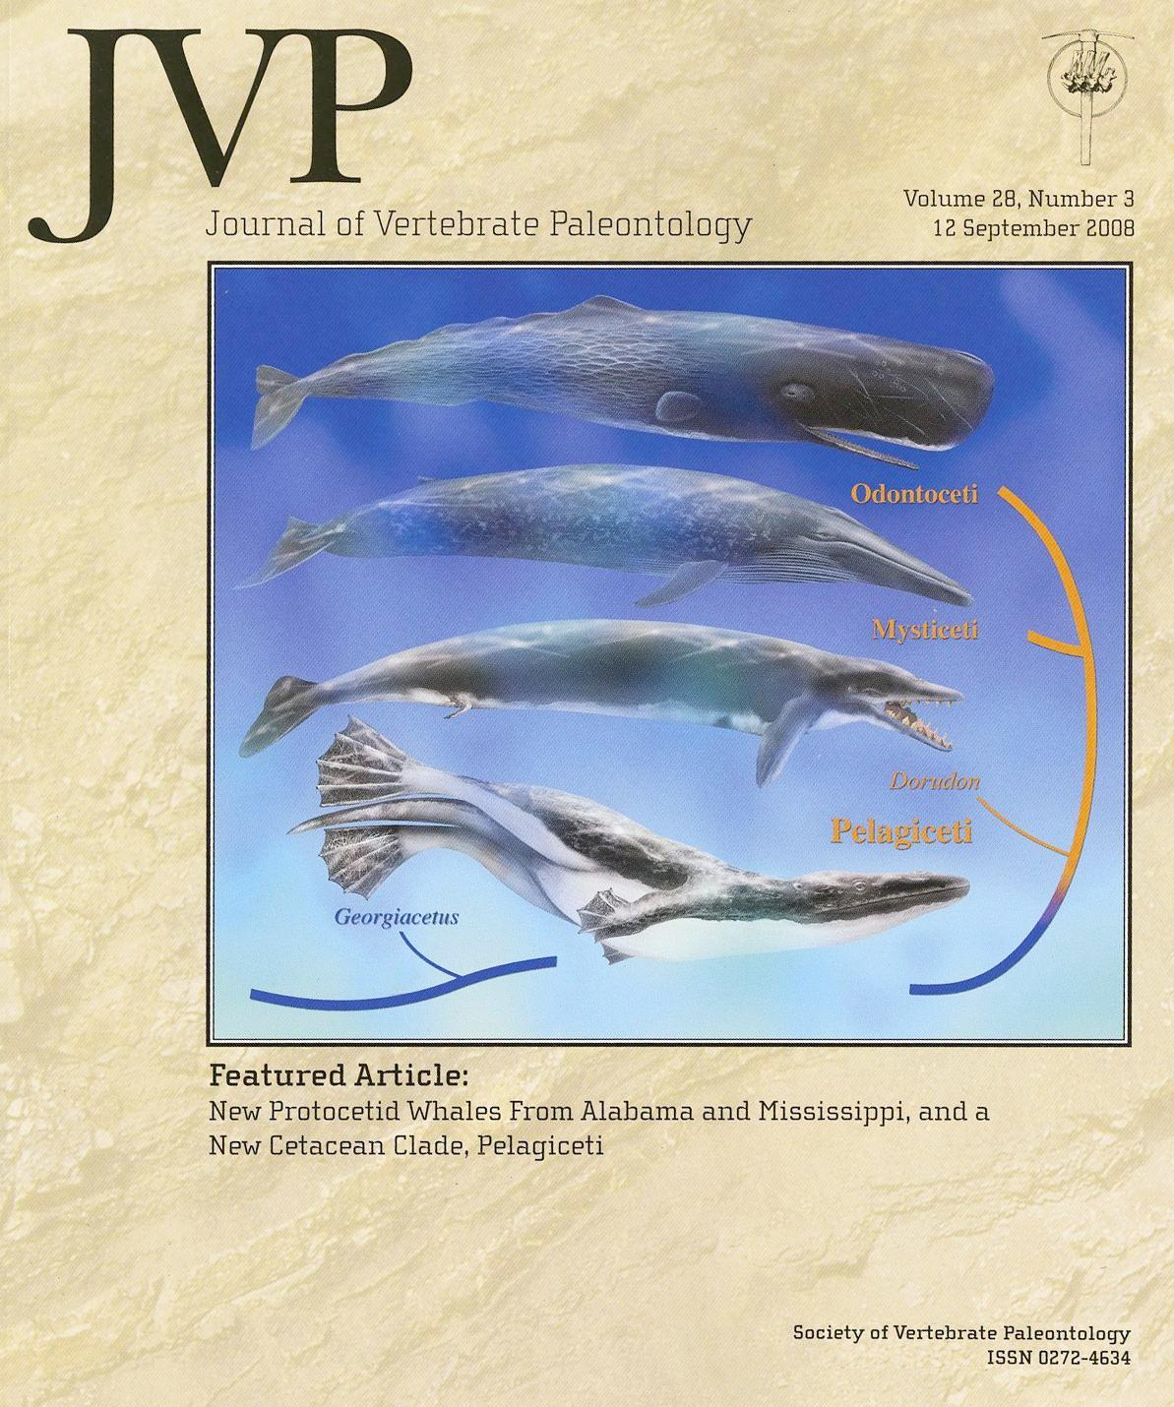
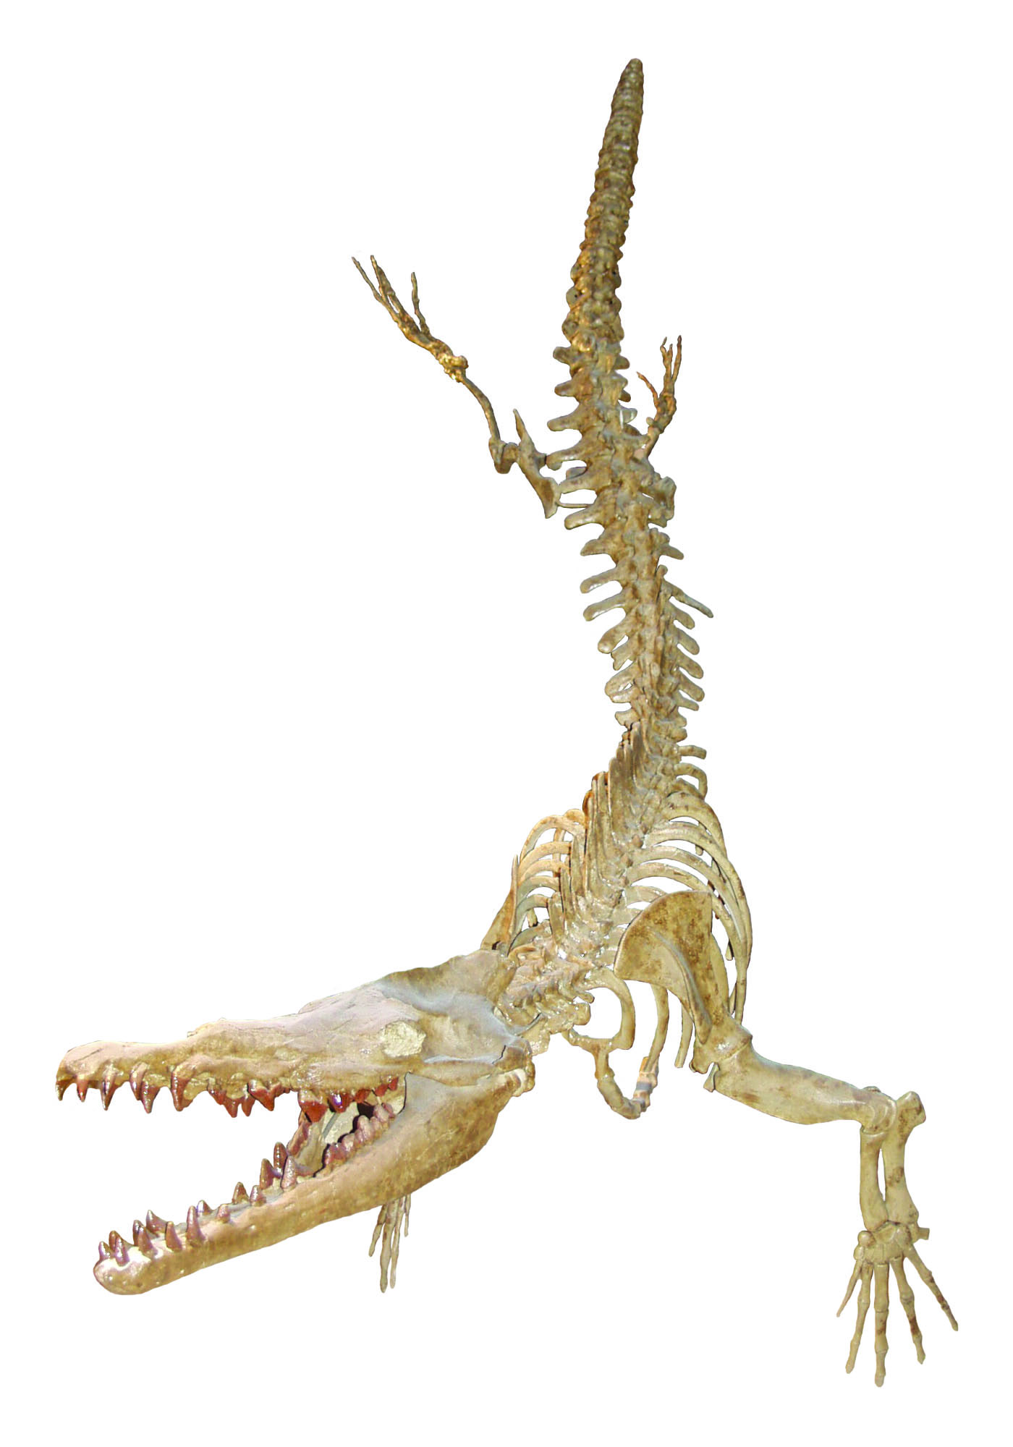

A Whale for Georgia
By
Thomas Thurman
GeorgiasFossils.com
How Our
Georgia Whale
Possibly Led
to All Modern Whales
Georgiactus votglensis on display at
Georgia Southern Museum in Statesboro
Image donated by Brent Tharp; Museum Director

Slide 2

“Why aren’t we given this?”
This work is dedicated to
South Georgia
Science Teachers
Especially those attending a 6/June/2018 presentation
“Georgia’s 500 Million Year Fossil Record”
at SW GA RESA in Camilla, GA.
Particularly that one teacher,
I don’t know her name,
which became frustrated when I briefly covered
Georgiacetus vogtlensis.
“Why aren’t we given this?”
There was a bit of annoyance in her voice.
Thanks again, Cheryl Clark, for the invitation to participate in the 2018 SW GA RESA Conference.
Always a treat.

Slide 3
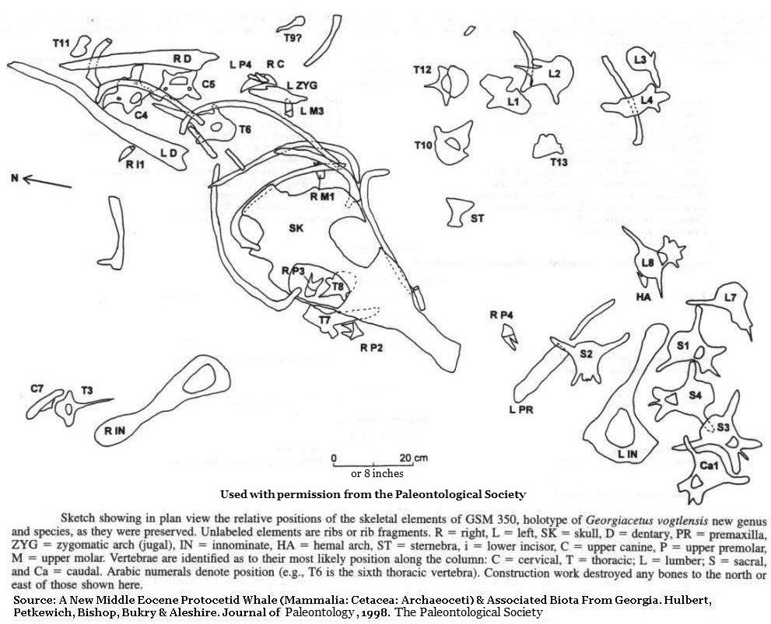

A New Whale
Discovered
During the 1983 construction of Nuclear Power Plant Vogtle fossils from three individual whales were recovered including one mass which represented 75% to 80% of a single, adult individual with fully erupted molars. All three individuals likely belonged to the same species.
All three individuals likely belonged to the same species.
For more on the discovery of Georgiacetus
http://www.georgiasfossils.com/10-a-whale-for-georgia.html

Slide 4
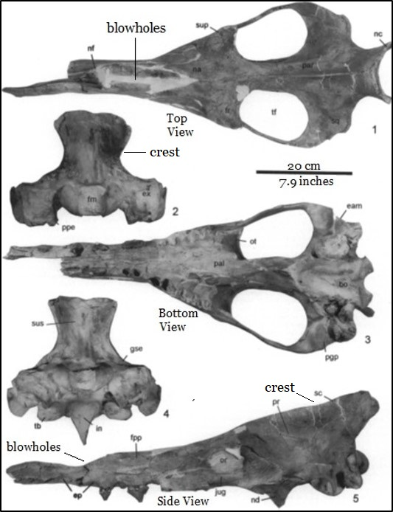
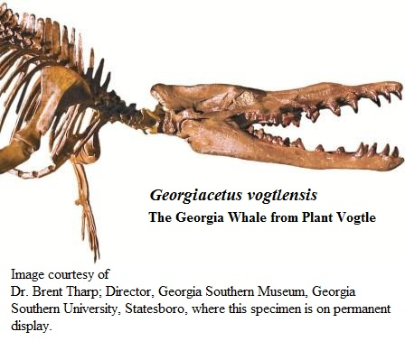
Georgiacetus was a large animal.
The skull is more than 30 inches long (76 cm)
Note large crest which anchored massive jaw muscles.

Slide 5
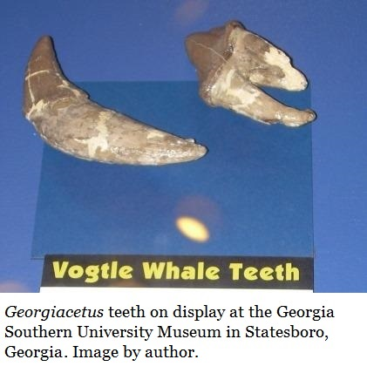
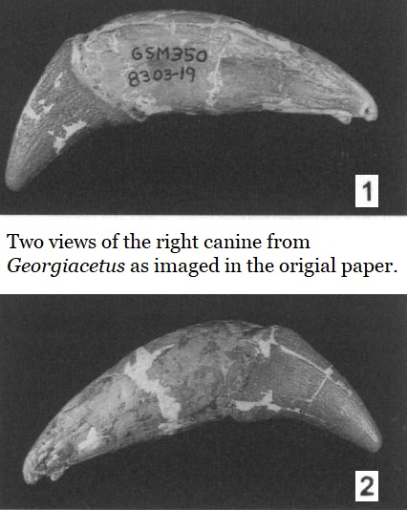
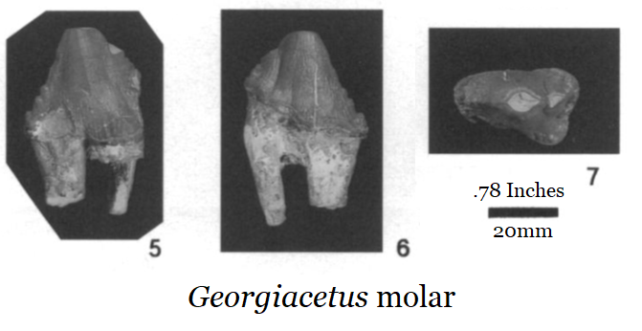
“The Better to Eat You With…”
Teeth of the Plant Vogtle whale from the original paper, except as noted.
Scale bar equal 20mm or .78 inches.

Slide 6

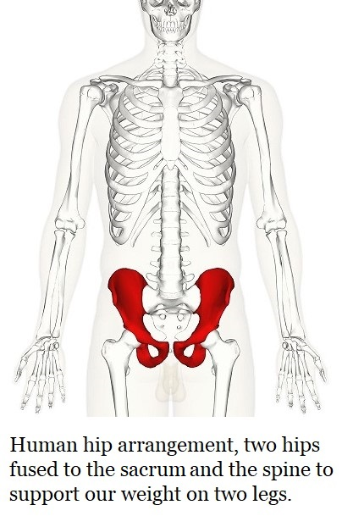
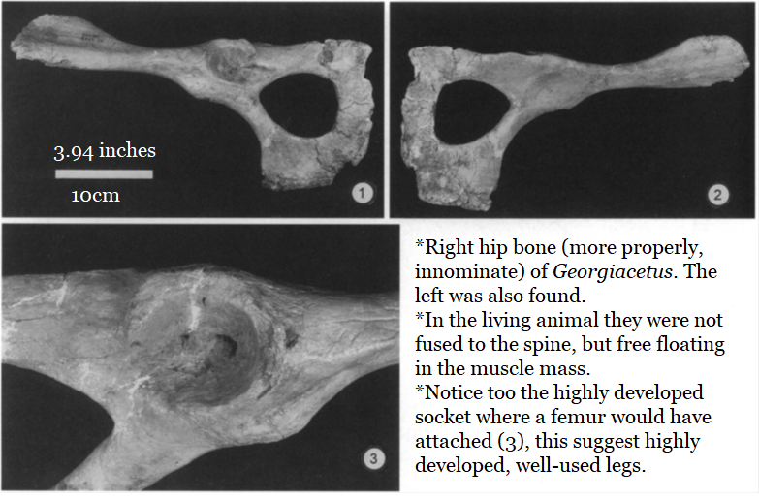
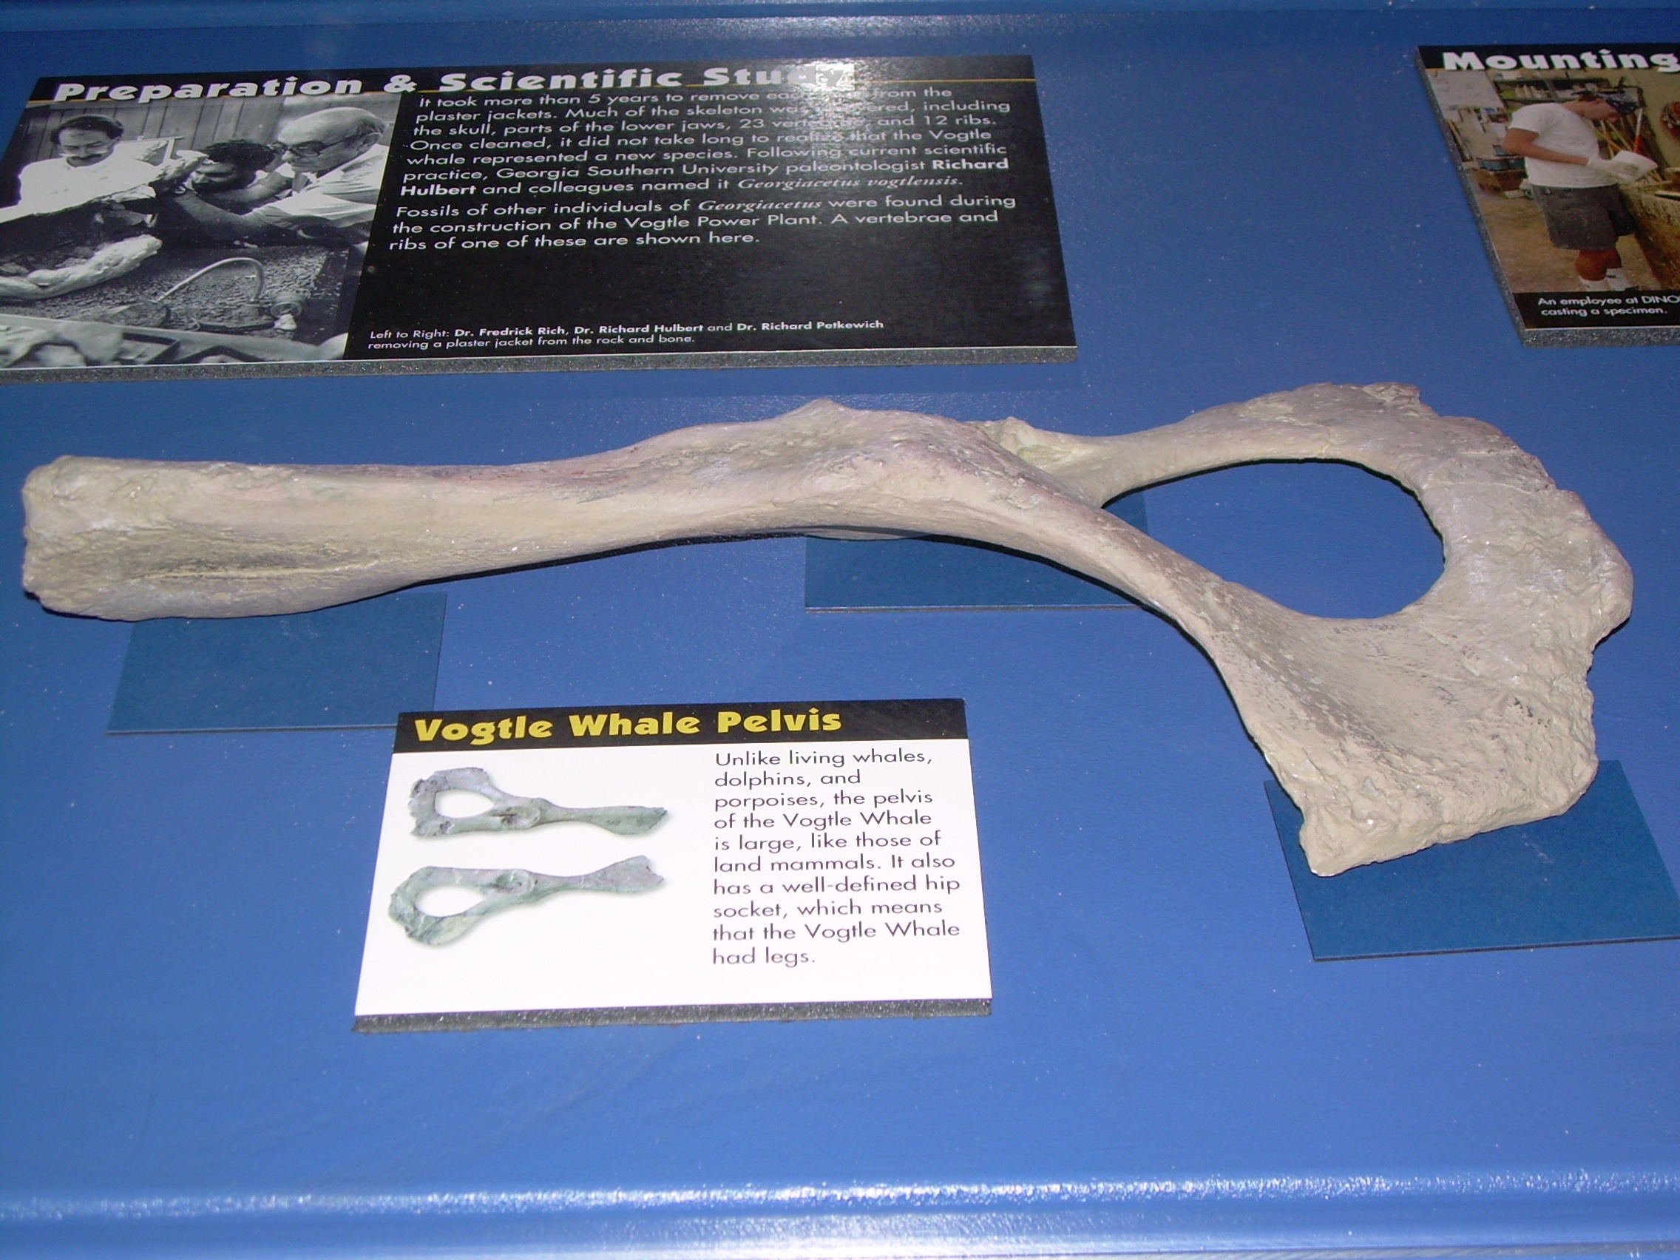
Fully Marine
Georgiacetus innominate on display at Georgia Southern Museum in Statesboro, Georgia.

Slide 7
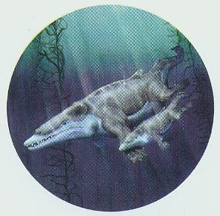
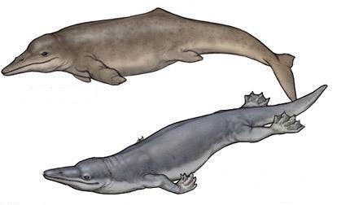
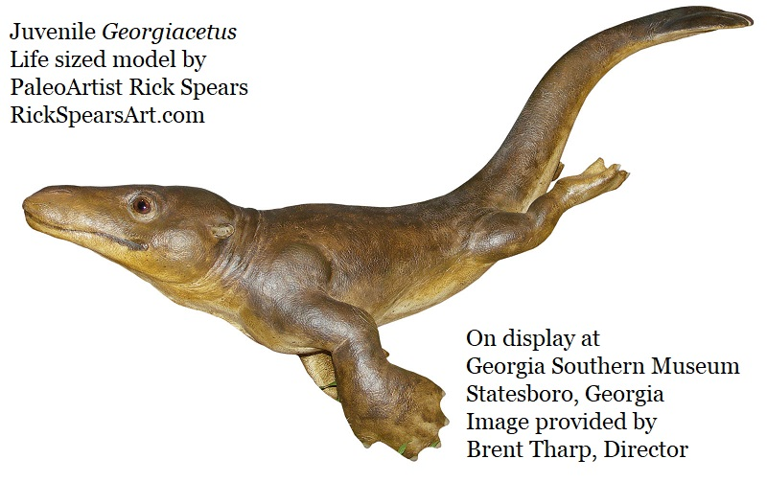
So… How Did Georgiacetus Swim?
Georgiacetus did not
swim like a tadpole!
The question moved next to ancestry.
How did Georgiacetus fit into the known history of protocetids, the protowhales?
How did it relate to the basilosaurids, which immediately followed it?
How might it relate to modern whales?

Slide 8
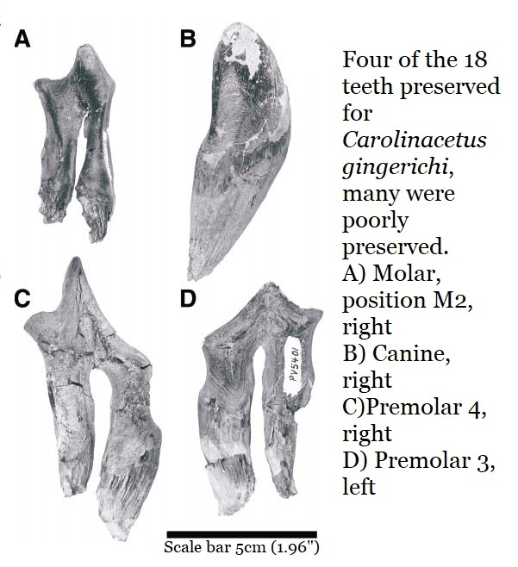
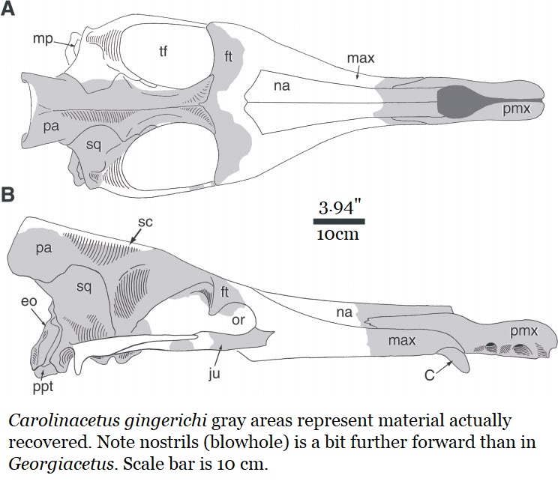
Older still… Enter Carolinacetus gingerichi
In July 2005 a new protocetid from South Carolina was announced by Jonathan H Geilser, Albert E. Sanders & Zhe-Xi Lou.

Slide 9
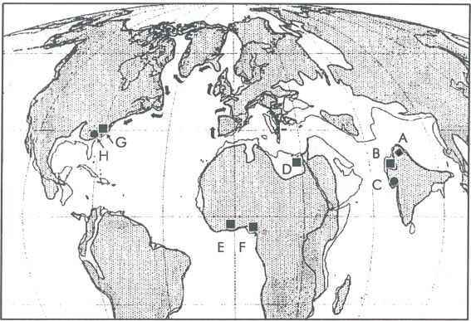
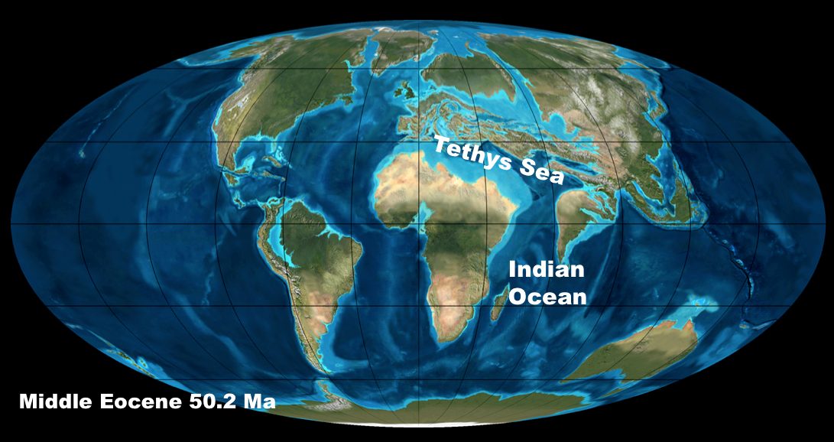
Oceangoing…..
Probable route protocetids took to reach the Southeast.

Slide 10
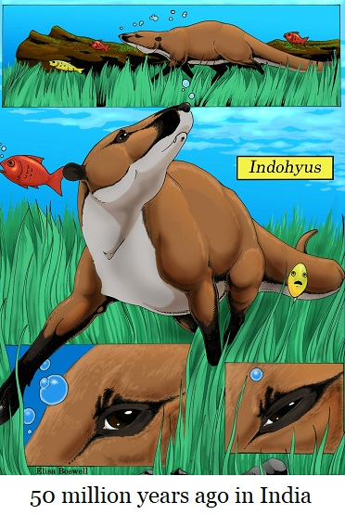
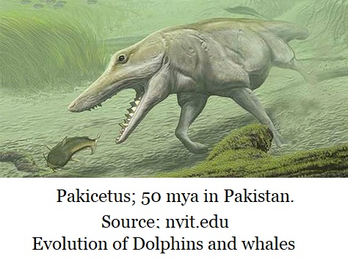
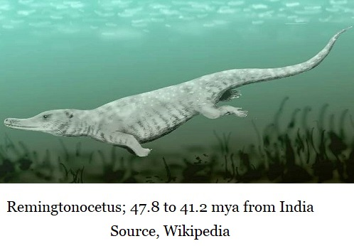
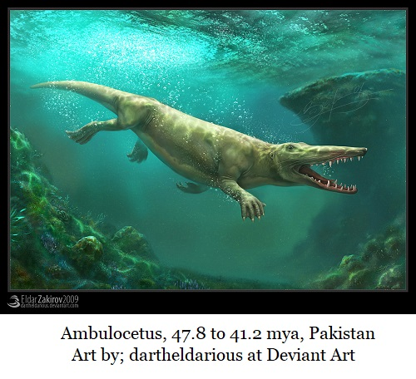
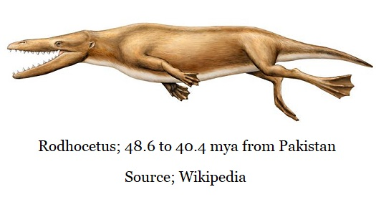
About 50 Million Years Ago
A group of mammals ventured into the sea…
Evolution dictates that related animals share common descent, a common ancestor.

Slide 11
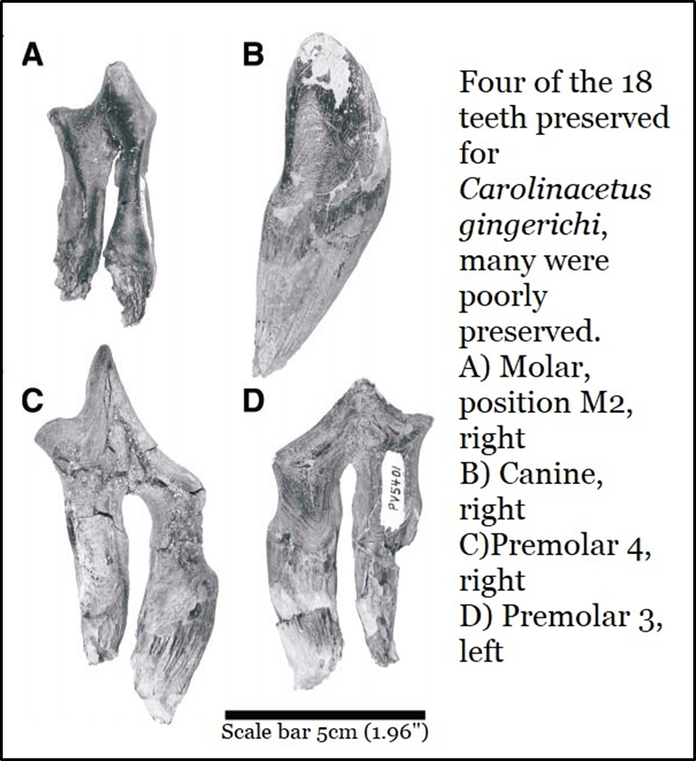
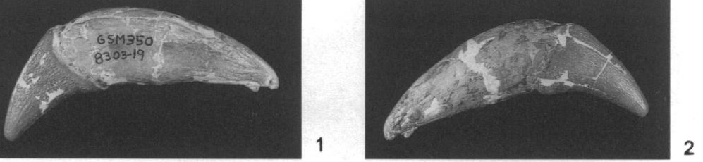
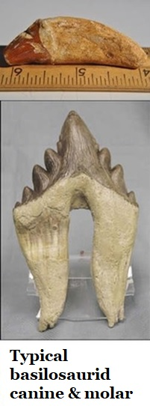
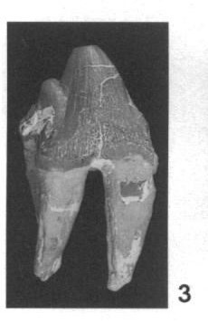
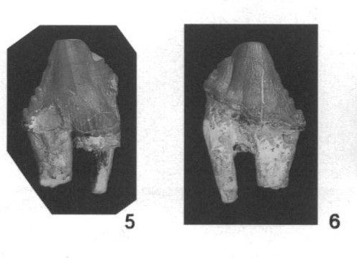
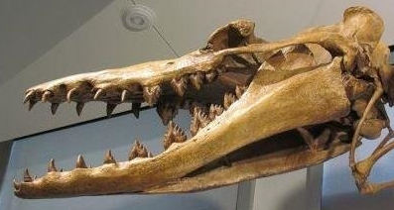
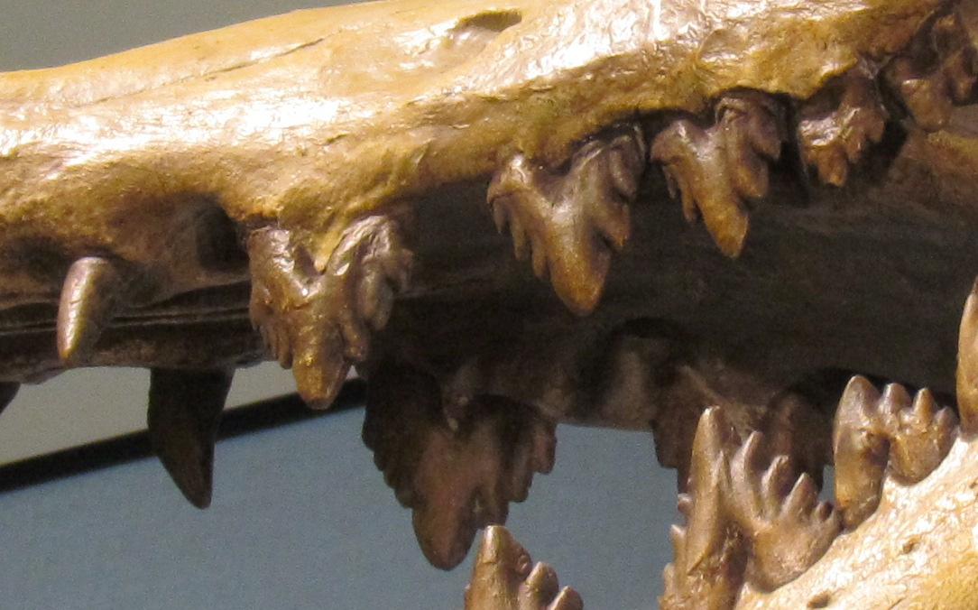
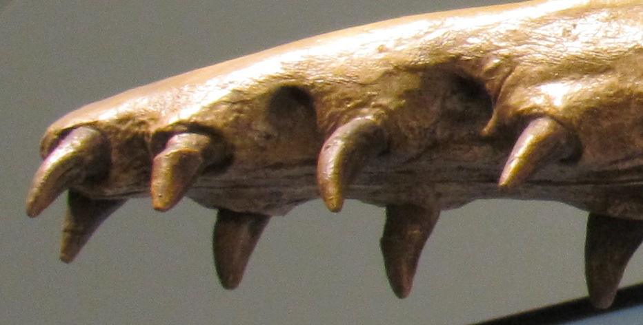
Protocetid & Basilosaurid Teeth Are Related
The progression of tooth development from protocetids to the basilosaurids.
Georgiectus teeth; two views of right canine (1&2), right premolar (3), left premolar (5&6).
Durodon
Images; Wikipedia

Slide 12

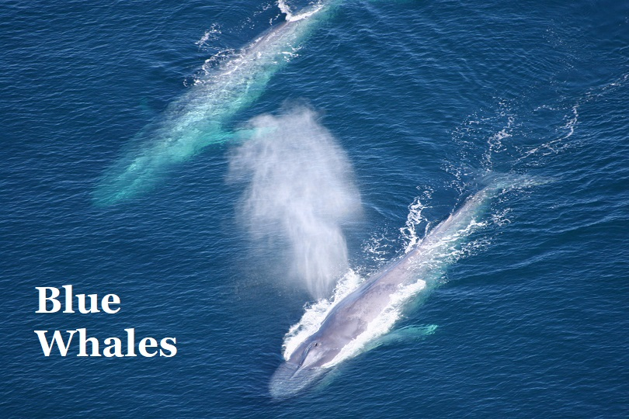
Common Ancestor to Modern Whales; Baleen & Toothed
Shared traits showing a common ancestor to all modern whales & dolphins;
They are carnivores
Horizontal flukes
Front flippers
Atrophied pelvis
Blowholes (nostrils) at the top of their head
Hearing as a primary sense
They’re mammals who nurse their young.
Toothed Whale Traits
(Including dolphins)
Teeth (at least at some point in life)
Keen underwater hearing
Single nostril
Melon or spermaceti organ
Active & highly developed echolocation
No sense of smell
Active predators
Many species highly social
Great variation in adult size
  Smallest; Hector’s dolphin, 1.4m (4.6ft)
  Largest; Sperm Whale, (male) 16m (52ft)
Baleen Whale Traits
Filter feeding baleen
Two nostrils
Retains basic sense of smell
Excellent unwater hearing
Echolocation not shown
Includes fastest whales
Includes largest whales
  Blue whales, 30m (98ft)
Most, but not all, feed on small fish & plankton.
Passive predators.

Slide 13
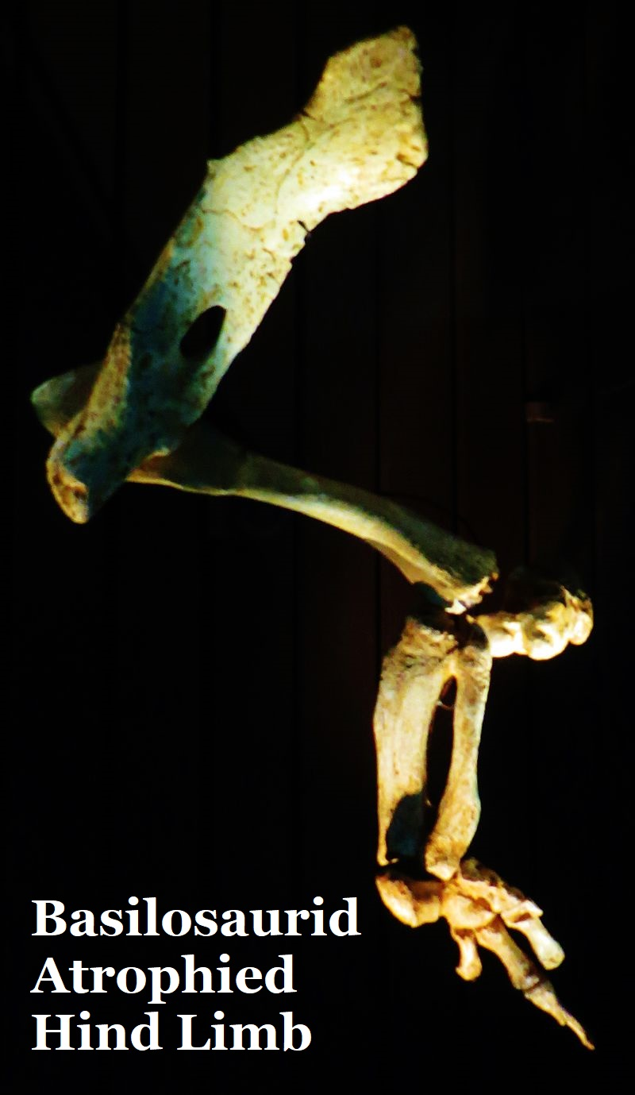
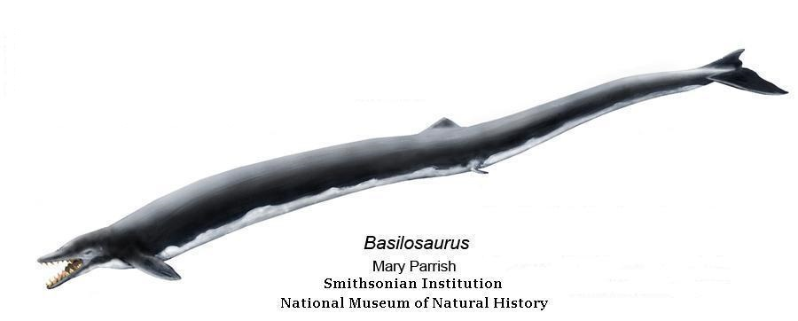
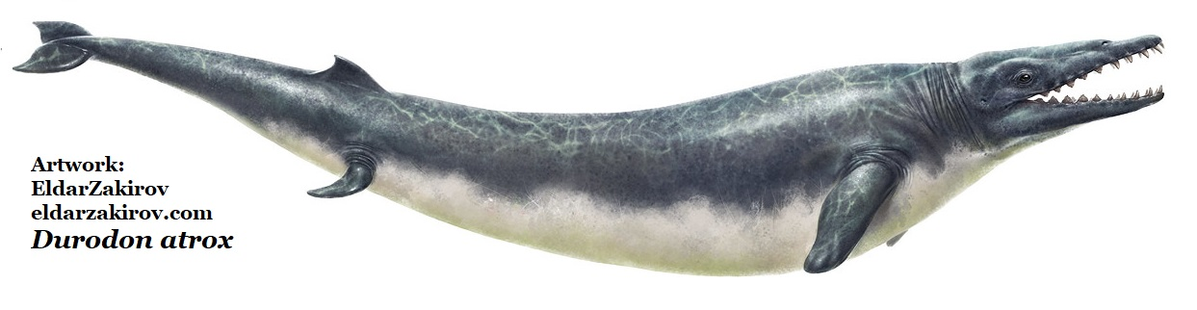
The Basilosaurids; The First Modern Whales
First of the Great Whales
Basilosaurus cetoides; living animals being 15 to 18 meters (50 to 60 ft) in length.
At up to 18 meters (60ft) long Basilosaurus cetoides
was twice the length of its 16 meter (20ft) cousin Durodon atrox.
Both frequently occur in many of Georgia’s Georgia’s 34 to 37 million year old fossil beds.

Slide 14
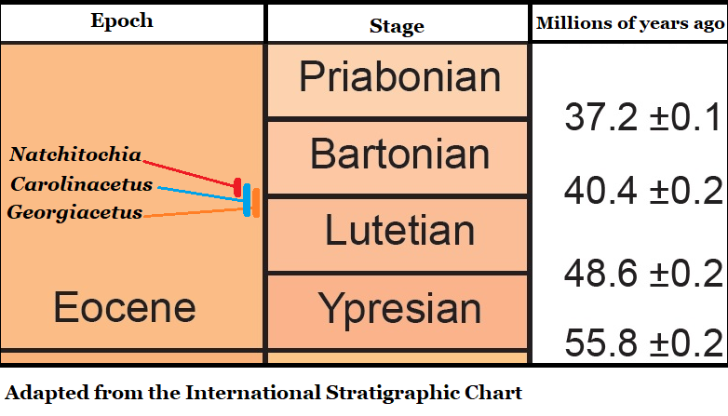
North America’s Known Protocetids
Natchitochia jonesi; 39.5-39.9 million years old
Known from Natchitoches County, Louisiana; 13 vertebrae and partial ribs.
Collected in 1943 by Paul H. Jones. Specimens were sent to the U.S. National Museum (which became the Smithsonian) where the Remington Kellogg recognized it as an ancient whale but never published the fossils.
Carolinacetus gingerichi;
39.7 - 42.4 million years ago
Known from South Carolina.
Slightly larger than Georgiacetus but shows many features which seem less advanced than the Vogtle Whale.
Georgiacetus vogtlensis;
39.8-42.4 million years old
Known from Georgia, Alabama & Mississippi.
Most advanced known protocetid.
Most complete skeleton.

Slide 15
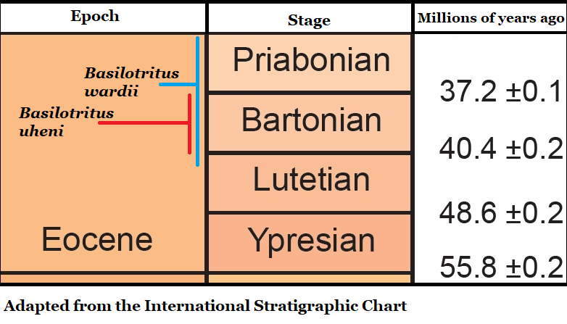
The Earliest Basilosaurid; Basilotritus
Basilotritus wardii;
(Formerly Eocetis wardii)
Possibly 33.9-42.0 million years old
Mark D Uhen, May 1999, Journal of Paleontology.
Known from North Carolina & Virginia
42 million year old sediments in North Carolina
Basilotritus uheni;
37.2-40.2 million years old
Pavel Gol’din & Evgenij Zvonok, March 2013, Journal of Paleontology
Known from North Carolina, Virginia, Egypt, Germany, Russia & Ukraine

Slide 16
A Southeastern Sea Full of Predators
The typical endurance of any particular species is roughly 10 million years.
Basilosaurids
Protocetids
It is likely populations of all 5 basilosaurid and protocetid species were present, at the same time, in the Southeastern Sea 40 million years ago.

Slide 17
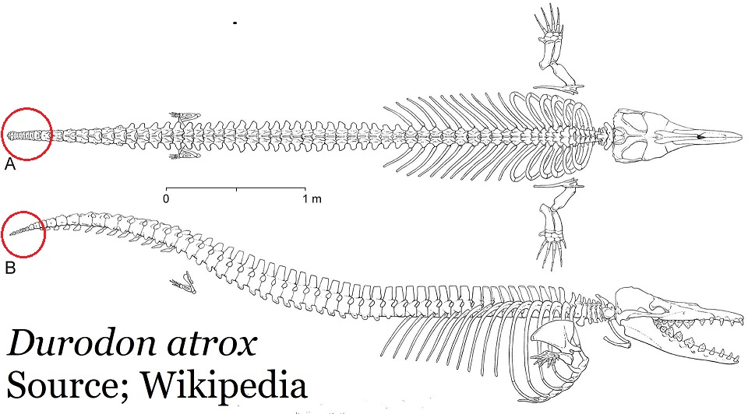
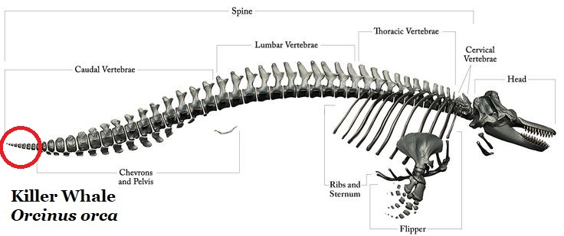
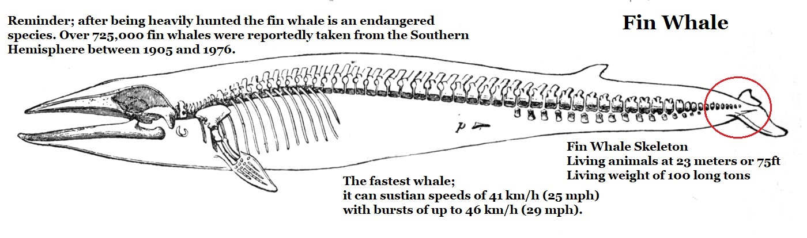
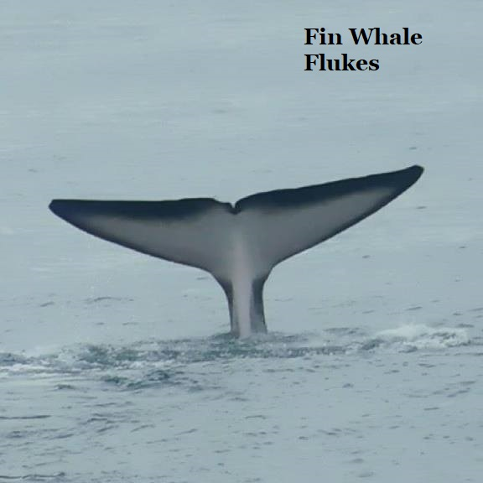
Flukes
Flukes are one of the key evolutionary adaptations which gave us of modern whales.

Slide 18
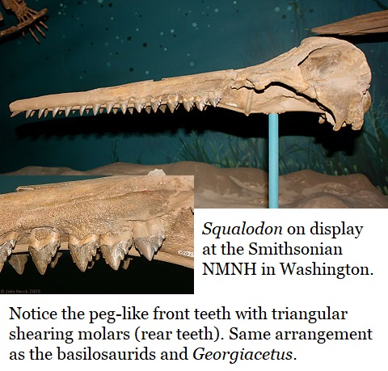
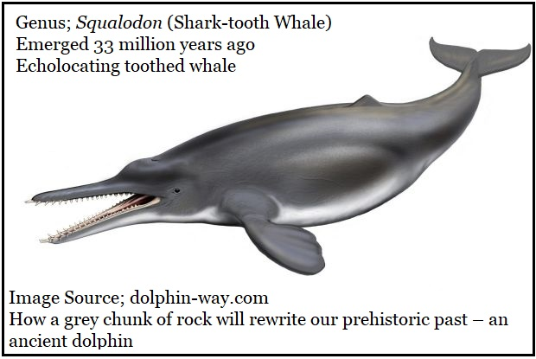
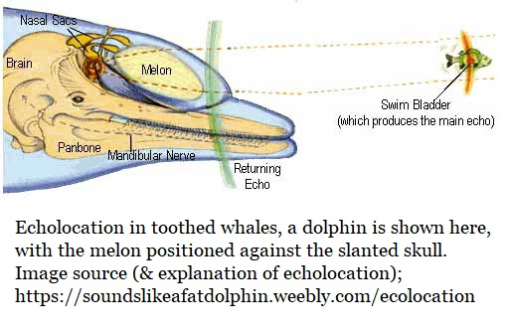
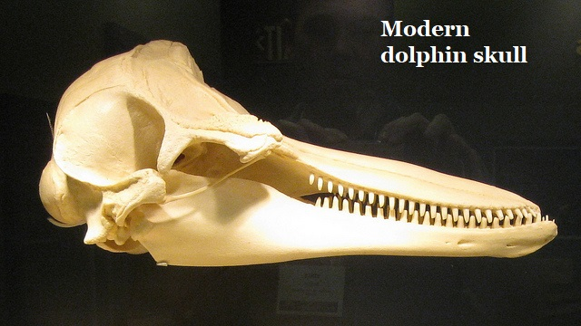
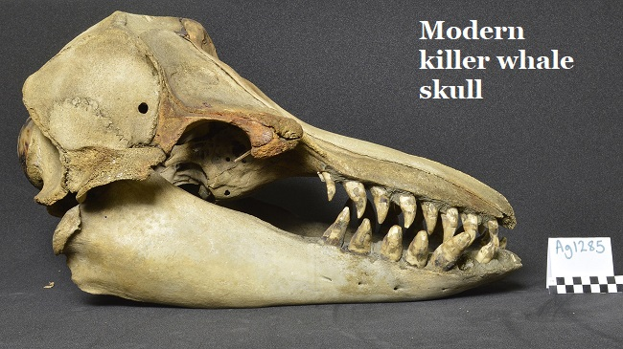
Toothed Whales (Odontoceti) Emerge
After the extinction of the basilosaurids 33 million years ago the genus Squalodon is present its tooth arrangement clearly shows ancestry through the basilosaurids.

Slide 19
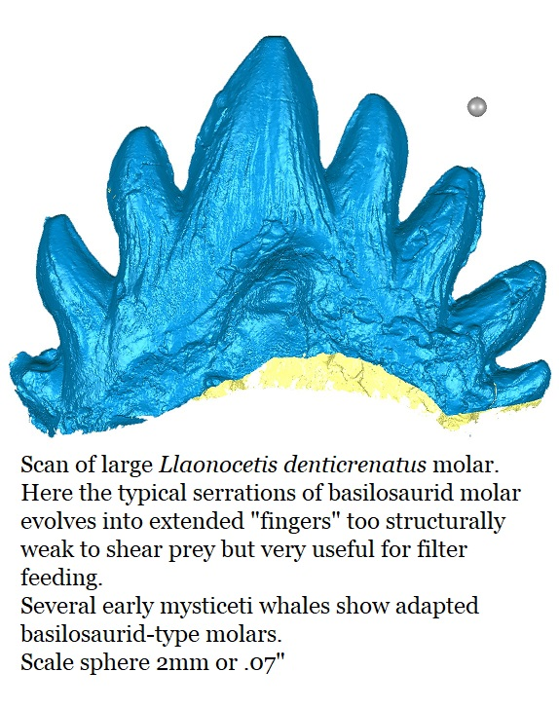
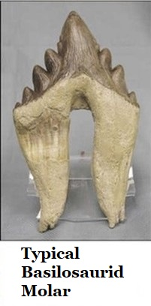
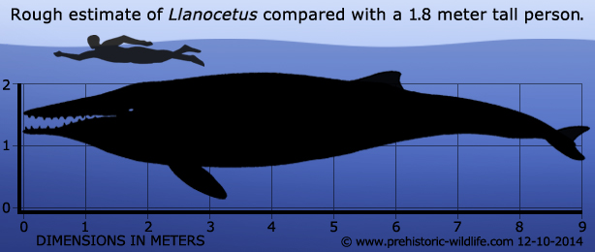
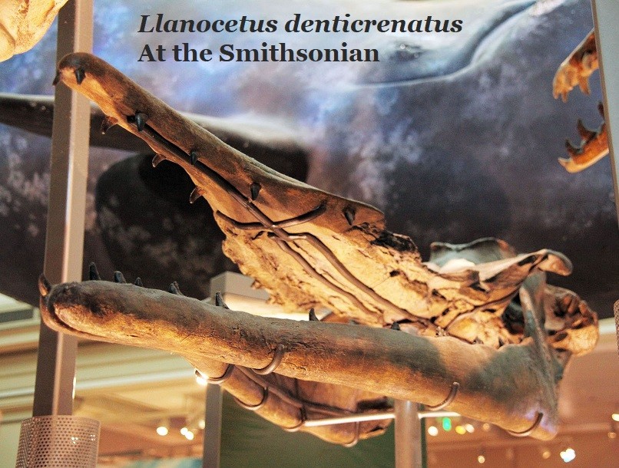
Baleen Whales (Mysticeti)
Emerge
Through the Basilosaurids
Nearly all of the earliest Mysticeti occur in the Southern hemisphere where their greatest diversity persists, its likely they emerged there.
Llanocetus denticrenatus is known from the 37.2-33.9 million year old sediments of Seymour Island, Antarctica. Current research puts it as the earliest known Mysticeti or baleen whale.

Slide 20


Both Baleen & Teeth; A Transition.
The genus Aetiocetus emerged 33.9 million years ago and possessed both basilosaurid-derived teeth & baleen, it endured for 10 million years in the Oligocene Epoch. It is a smallish whale known from Oregon, Japan & Mexico
The genus was established 1966 when the first individual was described by Douglas Emlong.
It currently contains 4 species.
Aetiocetus cotylalveus
Aetiocetus polydentatus
Aetiocetus tomitai
Aetiocetus weltoni

Slide 21

Georgiacetus goes national
In 2008 Mark D. Uhen, who was at the Smithsonian National Museum of Natural History at the time, published a paper that made the cover of the prestigious Journal of Vertebrate Paleontology and placed Georgiacetus vogtlensis as the probable ancestor to all modern whales.

Slide 22

A Case of Evolution in
Georgia’s Natural History
Uhen had access to new fossils.
These not only expanded the knowledge of Georgiacetus, but established that the whale was widespread in the sea which covered the Southeast.

Slide 23


Flukeless
Image A & B; two views of a probable Georgiacetus posterior caudal (end-of-tail) vertebra. This University of Alabama specimen was reviewed by Uhen.
It has two striking features;
It’s longer than it is wide
& it’s flanged.
This is the first such protocetid end-of-tail vertebra ever described, it’s probably from Georgiacetus.
Durodon possessed flukes; its end-of-tail arrangement matched modern whales.
The protocetid end-of-tail vertebra seen above is different.

Slide 24

The Ancestor of All Modern Whales?
In 2008 Mark Uhen argued that our Georgia whale, Georgiacetus vogtlensis, was clearly & closely related to the basilosaurids.
In essence, Uhen argued that Georgiacetus might be the ancestor to all modern whales.
Georgiacetus led to the basilosaurids.
The basilosaurids led to the toothed whales (odontoceti) and baleen whales (mysticeti).
On 13/Sept/2008 Mark Uhen was interviewed by
National Public Radio’s, All Things Considered;
Legs Propelled Whale Ancestor
https://www.npr.org/templates/story/story.php?storyId=94596835

Slide 25

Others Have Interpreted the Data Differently
Dr. Jonathan Geisler
is another respected researcher into whale’s natural history, he can be found at Department of Anatomy, College of Osteopathic Medicine, School of Arts & Sciences, New York Institute of Technology. NYIT maintains a webpage; Evolution of Whales and Dolphins.
https://www.nyit.edu/medicine/evolution_of_dolphins_whales
Geisler writes
“Locomotion: Unfortunately, very little of the tail of Georgiacetus is known, which makes it very difficult to interpret how well this cetacean could swim.
Recently, Uhen (2008) has suggested that Georgiacetus lacked tail flukes, based on a partially preserved caudal vertebra of a protocetid from Georgia.
However, it is uncertain whether this specimen can be referred to Georgiacetus and whether it was actually situated in the fluke-bearing portion of the tail.

Slide 26

Of course, a new fossil could upset all of these beautiful theories….
On 12/October/2011 the following headline in Argentina’s MercoPress caused a stir in the vertebrate paleontology communities;
“Argentine-Swedish team discovers 49 million-years fossil of fully aquatic whale in Antarctica”
Link to article;
http://en.mercopress.com/2011/10/12/argentine-swedish-team-discovers-49-million-years-fossil-of-fully-aquatic-whale-in-antarctica
To quote a passage of the article
“…Those earlier proto-whales were amphibians, able to live on land as well as sea. This jawbone, in contrast, belongs to the Basilosauridae group of fully aquatic whales…”

Slide 27

Basilosaurids in Antarctica
The fossils have not yet been assigned to any species nor has any new species been created.
The authors do, pointedly, state that the teeth are distinct from Llanocetus.
Several fossils were recovered from several layers in the stratigraphy, most were fragmentary and had to be reassembled in the lab.
Finds included mandibles, hips and teeth
Age; 40 to 46 million years old, but the authors freely admit that accurately dating the sediments has been problematic.

Slide 28

So… Did Our Georgia Whale Lead to All Modern Whales?
Probably not.
If the Antarctic basilosaurid finds are confirmed at 42 million years or more, they’ll be older than Georgiacetus.
*
Additionally;
Basilotritus uheni has been reported from Ukraine in sediments the same age as Georgiacetus, Basilotritus uheni is a basilosaurid, but it probably lacked flukes.
Georgiacetus remains the most advanced protocetids.
For a decade, it was considered the most likely ancestor to all modern whales.
Professional paleontologist at universities & museums depend on amateur researchers to do preliminary fieldwork and report fossils.

Slide 29

References, Researchers & Appreciation
The author would like to thank the following for advice & opinions in personal communications (alphabetical order).
Bobby Boessenecker; College of Charleston
Dana Ehret; Alabama Museum of Natural History
Bill Montante; Tellus Science Museum
George Phillips; Mississippi Museum of Natural History
Brent Tharp; Georgia Southern Museum
Ms. Amber Cherry; 3rd Grade Teacher, Dewar Elementary School
Ms. Paula Fraiser; Retired, Heart of Georgia RESA, Macon, GA
References:
1: A New Middle Eocene Protocetid Whale (Mammalia: Cetacea: Archaeoceti) and Associated Biota From Georgia; Richard C. Hulbert Jr, Richard M. Petkewich, Gale A. Bishop, David Bukry, & David P. Aleshire. 1998 Journal of Paleontology, 72(5) pg 907-927
2: A New Protocetid Whale (Cetacea: Archaeoceti) from the Late Middle Eocene of South Carolina; Jonathan H. Geilser, Albert E. Sanders, & Zhe-Xi Lou, American Museum Novitates, The American Museum of Natural History, 25/July/2005, Number 3480, 65 pp
3: New Protocetid Whales from Alabama & Mississippi and a New Cetacean Clade, Pelagiceti; Mark D. Uhen, Journal of Vertebrate Paleontology 28(3):589–593, September 2008
4: A New Cetacean from the Late Eocene La Meseta Formation, Seymour Island, Antarctic Peninsula, by E. D. Mitchell, published in the Canadian Journal of Fisheries and Aquatic Science, 1989
5: Argentine-Swedish team discovers 49 million-years fossil of fully aquatic whale in Antarctica; MercoPress, October 12, 2011, no by-line given
6: Eocene Basilosaurid Whales From The La Meseta Formation, Marambio (Seymour) Island, Antarctica, Mónica R. Buono, Marta S. Fernández, Marcelo A. Reguero, Sergio A. Marenssi, Sergio N. Santillana, and Thomas Mörs; Ameghiniana 53: 296–315, 2/Feb/2016.
7: Whales originated from aquatic artiodactyls in the Eocene Epoch of India. J.G.M. Thewissen, Lisa Noelle Cooper, Mark T. Clementz, Sunil Bajpai, B.N. Tiwari. Nature, Nature Publishing Group, Vol. 450, vol. 20, 27/December/2007

